Slide 1
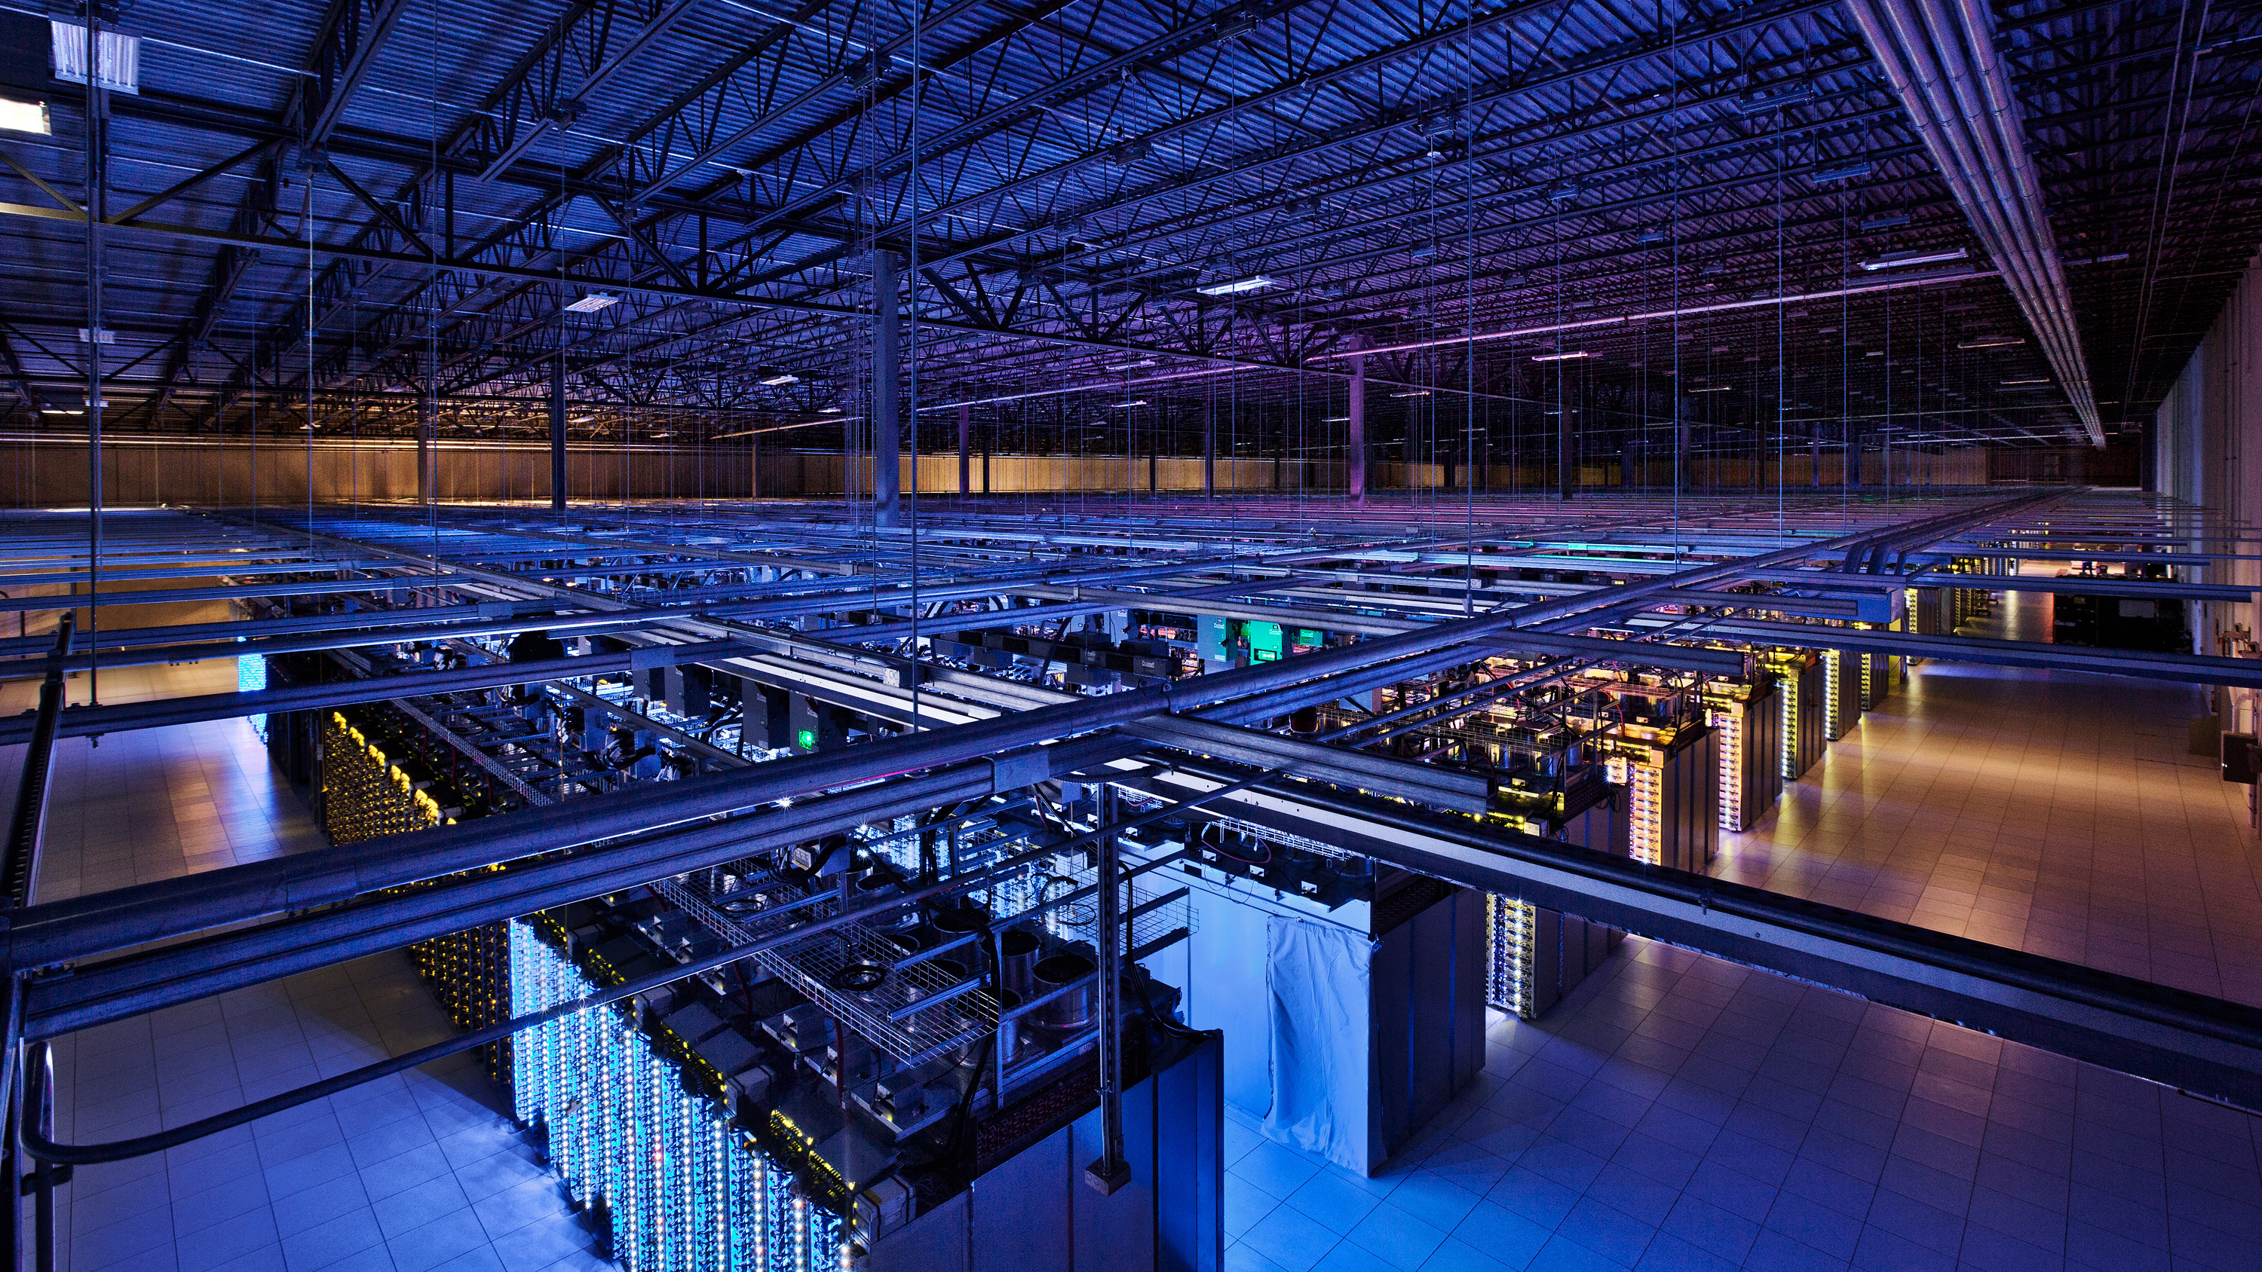
LinkGuardian Mitigating the impact of packet corruption loss with link-local retransmission
Raj Joshi, Qi Guo, Nishant Budhdev, Ayush Mishra, Mun Choon Chan, Ben Leong
Image Credit: Google Datacenters
Notes:
Hello everyone, today I’m going to talk about link guardian and which is a system for mitigating…
This is a joint work with my colleagues Qi Nishant Ayush and my advisors Mun Choon and Ben at the National University of Singapore

Slide 2
What is corruption packet loss?
The random packet loss that occurs due to packet corruption on a physical link.
Corrupted (bit flips)
1100101
Dropped by the
Receiver MAC
1101101
Ethernet Checksum
Fails
Notes:
A packet is essentially a sequence of bits and sometimes these bits can get corrupted and flip during packet transmission
When this happens, the Ethernet checksum fails and the packet is dropped by the receiving MAC

Slide 3
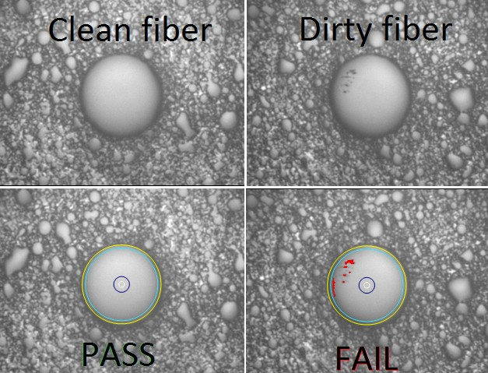
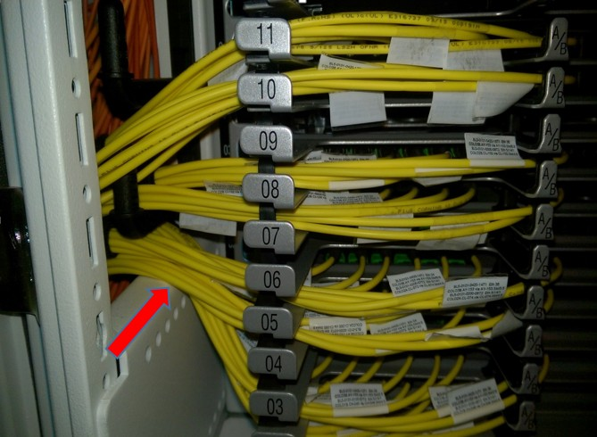
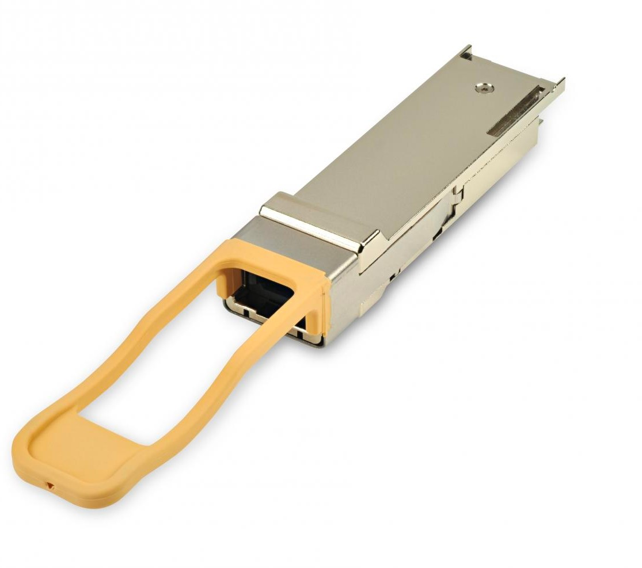
What causes packet corruption?
Switch-to-switch Links - Optical
Support high link speeds (up to 400 Gbps) over long distances (~100m)
Optical links – susceptible to corruption
Fiber Contamination
Fiber Bending
Decaying Transmitters
Airborne dust particles
Photo Credits: Zhou et al., SIGCOMM 2017
Notes:
In datacenter networks, switch-to-switch links tend to be optical because they support
However, optical links are susceptible to corruption due to various reasons. These include …

Slide 4
Why do we care?
Corruption Packet Loss – Significant
Comparable to Congestion Loss
Large-scale study (350K links, 15 datacenters)
[Zhuo et al., SIGCOMM’17]
Packet drops affected customers
due to corruption
[Zhou et al., SIGCOMM’20]
18%
Notes:
So, why do we care?
It turns out that, corruption packet loss can be significant in practice
A large-scale study by Microsoft …
Another study by AliBaba cloud …

Slide 5
Why do we care?
Affects Application Performance
(like any packet loss)
Increase in FCTs
Drop in throughput
For latency-sensitive flows
For throughput-sensitive flows
Notes:
And like any other packet loss it affects application performance by increasing the tail flow completion times for latency sensitive flows and causing a drop in throughput for throughput sensitive flows

Slide 6
How can we fix packet corruption?
Until then
Physical Repair
Mitigate
Several hours to days
Effects of packet corruption
Notes:
Well, physical repair is the only way to truly fix packet corruption. But this can take between several hours to days
Until then, we can only mitigate the effects of packet corruption

Slide 7
Existing Solutions to Mitigate Packet Corruption
Localize Impact
Capacity Proportional
End-host Agnostic
No network-wide disruption
to corruption loss rate
No end-host changes
Disabling the links
Network-wide disruption: re-routing of 1000’s of flows
Avoid corrupting links
[e.g. NetPilot, CorrOpt]
End-to-end redundancy
[e.g. RAIL, CloudBurst]
Link-local redundancy
[e.g. Wharf]
Incur higher reduction in capacity even for small corruption loss rate (e.g. 10⁻³)
Notes:
Now, there are some existing solutions to mitigate packet corruption, each with its own drawbacks…
One line of work tends to avoid gray failure links by simply disabling the links. However, this leads to network-wide disruption by causing re-routing of 1000’s of flows
Another line of work uses end-to-end redundancy but requires changes to the end-hosts
A 3rd line of work uses link local redundancy. However, similar to the others, it also incurs higher reduction…

Slide 8
LinkGuardian
Key Idea
Wireless Networks
Not explored in the context of datacenter networks
Link-local Retransmission
Within the network to recover corruption pkt loss
Notes:
LinkGuardian’s key idea is to do link-local retransmission within the network to recover from corruption packet loss
Now, link-local retransmission is not new and has been widely used in wireless networks. However, surprisingly, it has not been explored in the context of datacenter networks

Slide 9
Link-local ReTx in DC networks is non-trivial
A complete link-local ReTx scheme
Detect the packets lost
Hold on the transmission until lost packet is retransmitted
Put packets back in order to continue transmission
Challenging:
High link speeds
Dataplane h/w contraints
In this paper – first step
Investigating whether a simple out-of-order retransmission scheme could work in datacenter networks
Notes:
Doing link local retransmission in data center networks is nontrivial
A complete link local retransmission scheme would need to…
Now doing all of this in the data center context is challenging…
Therefore in this paper we take the first step towards this challenge by investigating whether…

Slide 10
In this talk
Small measurement study
Potential “recovery delay”: out-of-order reTx scheme
Insights
LinkGuardian
Design & Implementation
Evaluation Results
Notes:
In this talk, we will first see a small measurement study to measure the potential recovery delay of an out of order retransmission scheme
Then we will see the design and implementation of link guardian which is based on the insights from this measurement study
Finally we will take a look at the evaluation results

Slide 11
Recovery Delay for out-of-order ReTx
Simple out-of-order link-local ReTx scheme
Corruption
4
3
2
1
4
3
2
1
sw1
sw2
sw3
sw4
Loss notify: 3
Recovery Delay
Combined delay of these 2 packet transmissions
Retransmission: 3
Host 1
Host 2
Measurement Study
10 Gbps network with h/w timestamping on switches
* more details in the paper
Notes:
Consider a simple network where the link between switch 2 and switch 3 is corrupting packets
Now, a simple link local retransmission scheme, would look like the following
Switch 2 adds sequence numbers to all the packets it sends and also buffers a copy of recently sent packets
Now, suppose pkt 3 gets corrupted and dropped, then switch 3 would detect it based on the sequence numbers
And then notify switch2 that packet 3 is missing
After this switch2 would retransmit packet 3 to switch 3
Now the recovery delay for this link local transmission scheme would be the combined delay..
We conduct a small measurement study to measure this recovery delay using a 10 gbps network with hardware time stamping on switches,
and using ping to generate packets and measure the rtt.

Slide 12
Measurement Study – potential recovery delay
Measured Recovery Delays in µs
 | Link-local ReTx | End-to-end (kernel)
Mean | 2.59 | 32.73
50% | 2.59 | 32.50
99% | 2.60 | 44.00
10x lower
Implication for latency-sensitive flows
Smaller recovery delay → significantly reduce the increase in FCT due to packet loss
Notes:
The table here shows the distribution of the measured recovery delays in us, for both link local and end to end retransmission
We see that the recovery delays for link local retransmission are at least 10 X lower than end to end recovery
This has a direct implication for latency sensitive flows.. Because a smaller recovery delay significantly reduces

Slide 13
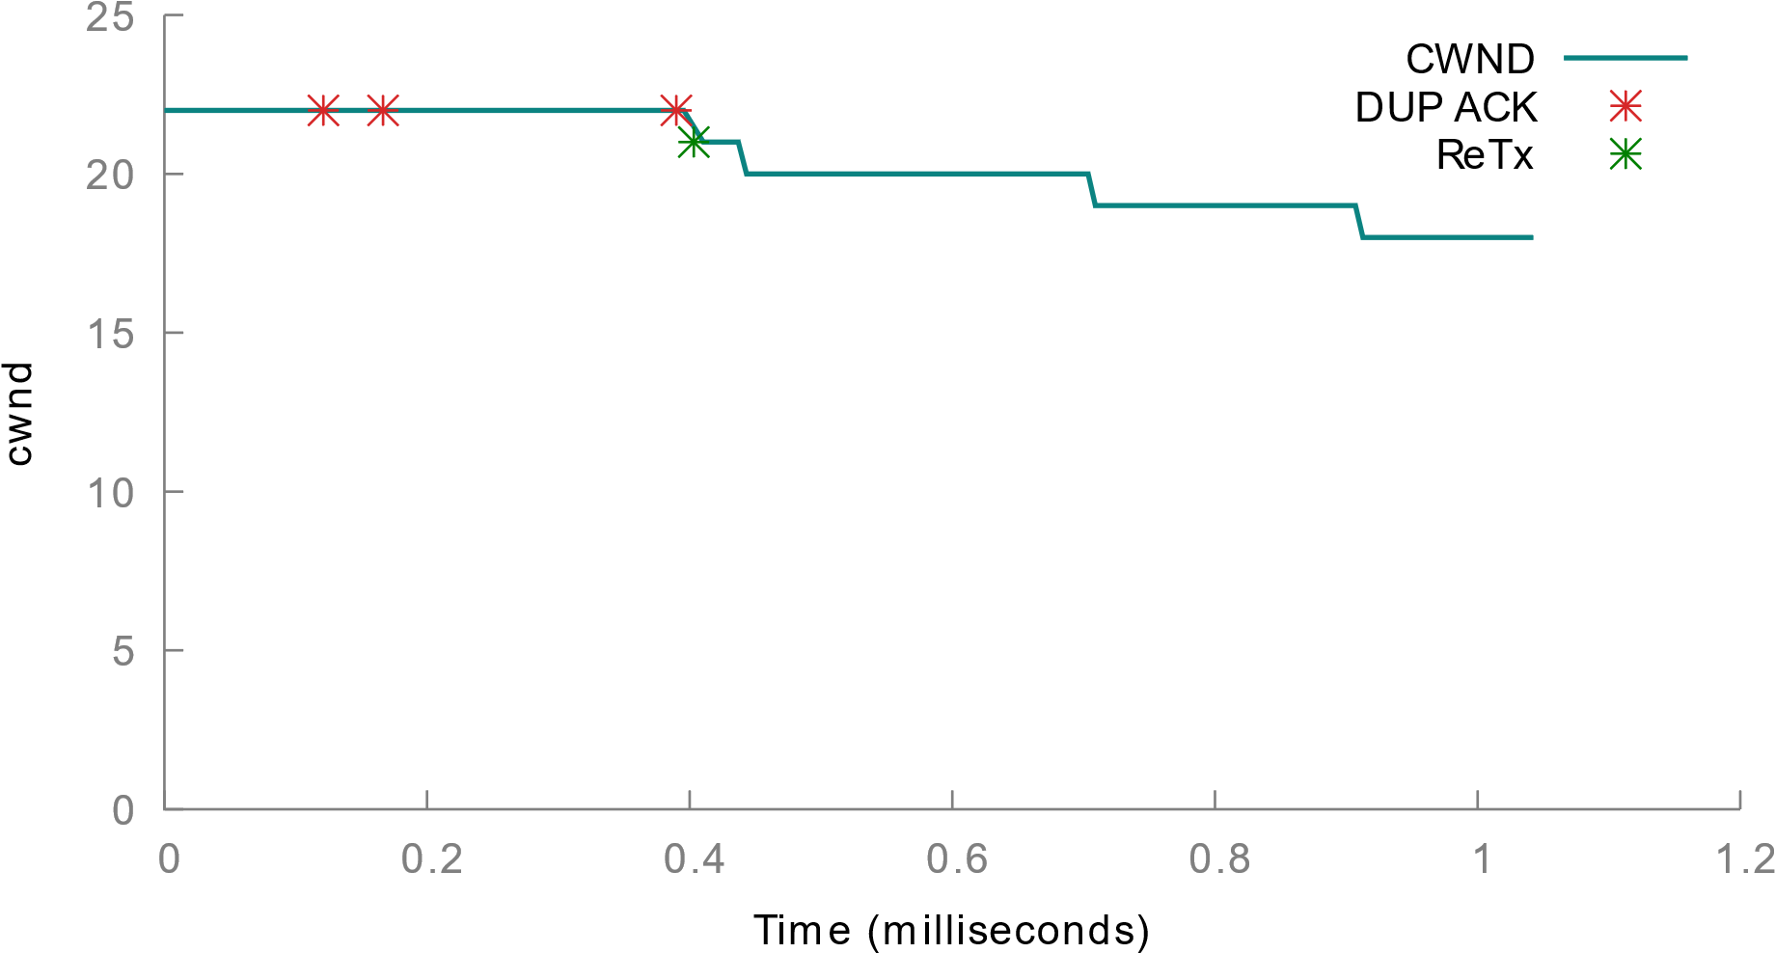
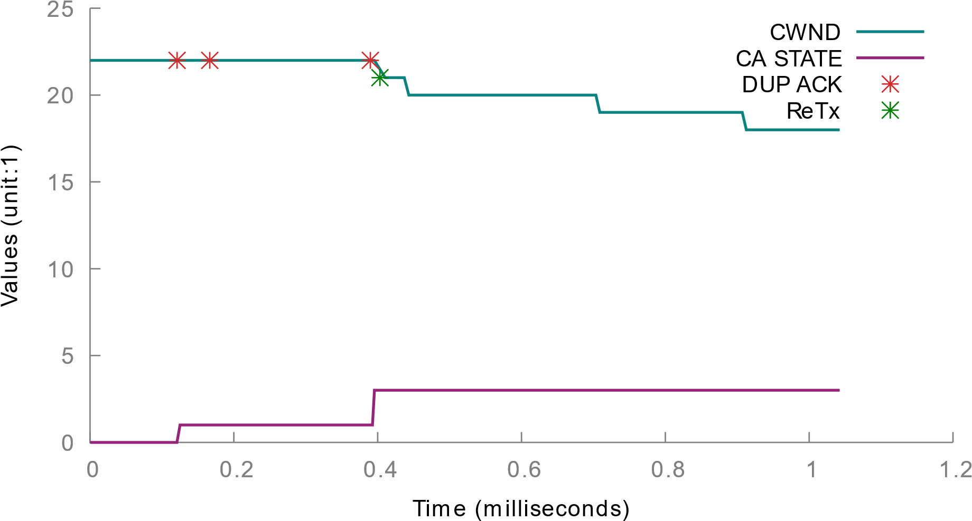
Implication for Throughput-sensitive TCP flows
Duplicate ACKs
TCP’s Reordering Window
First assumes, reordering and not loss
Reduces cwnd
@10 Gbps: 3.69µs
Does not immediately react to loss
Link-local recovery delay: 2.60µs
(measurements)
Reacts only after 3 subsequent data pkts
Recovery
We can retransmit a lost packet out-of-order within TCP’s reordering window:
→ Prevent triple duplicate ACKs and thus reduction of cwnd
Disorder
Open
Notes:
Now to understand the implications for throughput sensitive TCP flows, let’s look at this figure
.. which shows a snapshot of a TCP sender’s state when it experiences corruption packet loss
When corruption packet loss occurs, the subsequent packets trigger duplicate ACKs at the tcp receiver
We see that the sender does not immediately react to loss and reduce its congestion window, but it reacts only after 3 subsequent data packets are delivered
This is called tcp’s reordering window which at 10:00 gbps can be as small as 3.69 microseconds
However our measurement study shows that the link local recovery can be performed within 2.6 microseconds in the tail, which is less than the tcp’s reordering window.

Slide 14
Key Insight
Loss → reorder
Prevent performance degradation
Fast out-of-order Recovery
for end-host TCP
in the network dataplane
By avoiding end-host based loss recovery & reduction of cwnd
Notes:
So, to summarise, the key insight from our measurement study is that:
If we could do fast out-of-order recovery in the network dataplane, then we can masquerade the TCP loss events as reorder events for the end hosts. This can help us prevent performance degradation by avoiding end-host based recovery (which is slower) as well as prevent the reduction of congestion window.

Slide 15
LinkGuardian
Link corrupting
Network w/ LinkGuardian
Monitor the links for packet corruption
Activate
LinkGuardian
Runs normally when no link is corrupting
Using existing techniques
LinkGuardian protocol runs entirely in the dataplane
Notes:
Now, based on this key insight, we design link guardian and it works as following..

Slide 16
LinkGuardian Protocol
No Loss Scenario (no pkt gets corrupted)
Sender Switch
Receiver Switch
seqNo=5
latestRxSeqNo=5
seqNo=0
latestRxSeqNo=0
5
4
3
2
1
5
4
3
2
1
Buffer
PktGen
latestRxSeqNo=0
latestRxSeqNo=5
Cumulative ACK
Periodic ACKs
Notes:
Now let’s look at the link guardian protocol
Since packet corruption is typically unidirectional..
Now the sender switch maintains a monotonically increasing sequence number while the receiver switch maintains the latest received sequence number
A copy of the latest received sequence number is also maintained by the sender switch
Now let’s look at the no loss scenario..
When packets are to be sent out, the sender adds sequence numbers to them and creates a copy of the packets for buffering
On receiving the packets the receiver switch updates the latest received sequence number, in this case to 5
The receiver switch uses the packet generator to generate periodic ACKs which read the latest received sequence number and update it on the sender switch.
This serves as a cumulative ACK and the sender switch knows that the receiver switch has received all the packets till sequence number 5
It then drops the buffered copies of the packets since they all have been successfully delivered
The packets on the receiver switch, do not stop and they simply continue ahead on their path
It first adds sequence numbers to these packets.
Then makes copy of these packets while transmitting them.

Slide 17
LinkGuardian Protocol
Loss Scenario (pkt 4 gets corrupted)
Sender Switch
Receiver Switch
seqNo=5
latestRxSeqNo=5
seqNo=0
latestRxSeqNo=0
5
4
3
2
1
High priority
5
4
3
2
1
Buffer
4
PktGen
latestRxSeqNo=0
6
latestRxSeqNo=5
Low priority
Periodic ACKs
ReTxRequests
Loss Detection
4
Packet sequence at TCP receiver
6
4
5
3
2
1
Loss notification pkt (high priority)
Single Duplicate ACK
Notes:
Now let’s look at the last scenario where packet number 4 gets corrupted..
In this case, everything works the same as before except that packet number 4 is corrupted and the receiver switch does not receive it
The receiver switch has a loss detection mechanism, which uses sequence numbers to determine that packet 4 has been lost
It then generates a loss notification packet and sends it with high priority to the sender switch
The sender switch maintains another data structure called retransmission requests
The loss notification packet updates this data structure as well as the latest received sequence number
This information tells the sender switch that the receiver switch has received everything until sequence number 5 except that it is requesting retransmission for sequence number 4
The receiver switch then drops all the buffered packets except packet number 4
Meanwhile at the receiver switch the packets 1 2 3 and 5 continue on their path
The receiver switch then retransmits packet number 4 using a high priority queue
This ensures that even if there is a subsequent packet 6, the retransmitted packet pre-empts it and the transmission completes within the TCP reordering window
The final packet sequence at the tcp receiver looks like the following, where only a single duplicate ack is triggered by packet number 5
… So this is how the link guardian protocol works at high level.

Slide 18
LinkGuardian Protocol
Loss detection at the receiver switch
Packet buffering at the sender switch
Comparing seq # of current packet and the latestRxSeqNo
Currently achieved through recirculation
Refer to the paper for more details
Notes:
Now, the loss detection at the receiver switch works by comparing…

Slide 19
Evaluation
Implementation
Intel Tofino ~900 lines of P4
Evaluation setup
10 Gbps 3-stage Clos network: Intel Tofino switches and Xeon servers
Random generator on Tofino: emulate corruption packet loss (different rates)
TCP flows: CUBIC and DCTCP
Compare
No mitigation
Mitigation using Wharf [NetCompute ’18]
Provides link-local redundancy
Notes:
We compare link guardian with doing no mitigation and doing mitigation using Wharf that provides link local redundancy

Slide 20
Mitigate impact on throughput-sensitive flows
TCP Throughput in Gbps
Loss rate → | 0 (baseline) | 10⁻⁵ | 10⁻⁴ | 10⁻³ | 10⁻²
CUBIC | 9.49 | 9.48 | 7.28 | 3.43 | 1.33
+ Wharf | n/a | 9.13 | 9.13 | 9.13 | 7.91
+ LinkGuardian | 9.47 | 9.47 | 9.47 | 9.46 | 9.28
* similar results for DCTCP (see paper)
Wharf: FEC redundancy overhead for all packets
LinkGuardian: retransmits only the lost packets
Notes:
Whereas, among the mitigation techniques, link guardian achieves higher throughput than Wharf for all the loss rates
This is because, Wharf adds FEC redundancy overhead..

Slide 21
Mitigate impact on latency-sensitive flows
FCT distribution (in 𝜇s) for 45KB “affected” DCTCP flows
Loss rate → | 0 | 10⁻³
 | Baseline | Loss | Loss + LinkGuardian
min | 113 | 193 | 143
mean | 197 | 707 | 375
50% | 180 | 419 | 258
90% | 311 | 2421 | 424
95% | 315 | 3216 | 455
99% | 329 | 4192 | 3540
↑ 10x
↓ ~85%
Tail losses
* more results in the paper
Notes:
Now, for latency sensitive flows, the table here shows the FCT distribution in microseconds …
We see that at the 95th percentile, a corruption loss rate of 10 to the power -3 can increase the flow completion time by about 10X.
However, link guardian mitigates this by reducing the increase in FCT by about 85%

Slide 22
Overheads
Packet buffering at the sender switch
Packet buffer: 5.44 KB (3-4 packets) @10 Gbps
Periodic ACK packets
Link capacity overhead: 1%
Overall, the overheads for LinkGuardian remain low.
Notes:
In our current implementation, the packet buffering at the sender switch requires packet buffer of only 3 to 4 packets while running at 10 gbps
Whereas, the periodic ack packets incur a link capacity overhead of about 1%
Extra data: Sequence number headers: 0.2%

Slide 23
Future directions
Scalability
Currently, works for a 100 Gbps link, as long as individual TCP flows <= 10 Gbps
Investigate: can support individual TCP flows > 10 Gbps
Preserve packet ordering (ordered in-network retransmission)
Beneficial for end-point transports that may not be reordering tolerant (e.g. RDMA)
Buffering packet copies without recirculation
Next gen programmable switches (Intel Tofino2) provide primitives with which this seems plausible

Slide 24
Conclusion
Packet Corruption Loss
Can be significant in datacenter networks. Affects application network performance
LinkGuardian
Loss → reorder
Prevent performance degradation
Fast out-of-order Recovery
for end-host TCP
in the network dataplane
By avoiding end-host based recovery & reduction of cwnd
Preliminary results → promising approach for mitigating pkt corruption

Slide 25
Thank you!
Credits: This presentation template was created by Slidesgo, including icons by Flaticon.
Flaticon icons by: Becris, Vectors Market, Flat Icons, Maxim Basinski Premium, Darius Dan, noomtah, iconixar, Kiranshastry, Bombasticon Studio, fjstudio, Vectorslab, Chattapat, Freepik, Andy Horvath, itim2101, Pavel Kozlov, srip, Icongeek26, mangsaabguru, kank, and Pixel perfect.

