Slide 1



Capybara: 𝜇Second-Scale Live TCP Migration
Inho Choi¹, Nimish Wadekar¹, Raj Joshi¹, Joshua Fried²,
Dan R. K. Ports³, Irene Zhang³, and Jialin Li¹
¹National University of Singapore, ²MIT CSAIL, ³Microsoft Research
Notes:
Hello everyone.
I’m Inho from NUS, and today I’m going to present Capybara: …
This is joint work with Nimish, Raj, Josh,

Slide 2
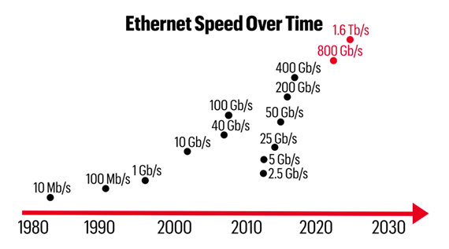
Data centers operate in 𝜇s-scale
TCP Echo Latencies (𝜇s)
30.4
Single-digit 𝜇s
packet delivery
𝜇s-scale predictable tail latency
is feasible in data center applications
Kernel-bypassing
6.6
7.1
Linux
Caladan
[OSDI ‘20]
Demikernel
[SOSP ‘21]
https://www.networkcomputing.com/data-centers/pursuit-16t-data-center-network-speeds#
Notes:
Recent datacenter network speeds have been making great improvements, and operate in us scale today.
Ethernet speed, particularly in large-scale data centers, is getting faster in exponential way, enabling single-digit-us packet delivery latencies.
Also in the system software side, recent kernel bypassing network stacks like Caladan or Demikernel demonstrates even sub-us scale TCP processing, which enables single-digit-us latencies for simple TCP applications like Echo.
With these advanced networking speeds, μs-scale predictable tail latency is feasible in data center applications.

Slide 3



Challenge: Unpredictable Server Overload
Traffic Volume
Time
Load Imbalance
Bursty Traffic
Unpredictablity
Notes:
However, achieving this in real world is still challenging due to unpredictable server overload. Server overload happens due to various reasons including
load imbalance across servers,
bursty request traffic,
and unpredictable request patterns.
Overloaded servers prevent applications from taking the advantage of network speeds, and typically cause poor tail latency.

Slide 4


Existing approaches for load balancing
Can we migrate live TCP connections across servers?
Frontend Proxy
Switch-based load balancing
NetCache [SOSP ‘17]
Pegasus [OSDI ‘20]
Client
Client
Switch
Switch
Backend
Frontend
Backend
Frontend becomes bottleneck
Hard to be applied to most data center applications (TCP)
Notes:
To solve this problem, various load balancing systems have been deployed and proposed in data centers.
The traditional frontend proxy architecture literally uses frontend servers as load balancers which is mediating client requests and relay them to multiple backend servers.
Although this architecture has been widely deployed, it has some fundamental limitations that the frontend server is typically responsible for handling many concurrent clients, which creates a bottleneck of the entire system.
On the other hand, recent work such as NetCache or Pegasus propose a new approach by leveraging programmable switches to perform dynamic load balancing.
In this system, the switch dynamically decide where to forward client requests by interacting with servers to track the current workload.
It achieves significant performance improvements even under dynamic and skewed realistic workloads.
However, this approach only works for single packet-sized requests over custom UDP-based protocols, so its hard to be applied in most data center applications relying on TCP.
So, to achieve the dynamic TCP load balancing in data centers, we ask if we can migrate established TCP connections across servers.

Slide 5
Existing Load Balancing Approaches
L7 per-request frontend proxy
NGINX
Clients
…
☒ Scalability
Backend
Frontend
Backend
Notes:
To solve this problem, various load balancing approaches have been deployed and proposed in data centers.
Frontend proxy is a traditional per-request load balancer at layer 7, which is used by popular web server software like Nginx.
It literally uses frontend servers to relay the traffic in between clients and backend servers. Although this architecture has been widely deployed, it has a fundamental scalability limitation that
the frontend server is typically handling many clients concurrently, and becomes the bottleneck

Slide 6
Existing Load Balancing Approaches
L7 per-request frontend proxy
NGINX
Clients
…
☒ Scalability
Load balancing by switch
Switch
Per-packet distribution
SwitchKV [NSDI ‘16]
NetCache [SOSP ‘17]
Pegasus [OSDI ‘20]
…
☒ TCP support
Backend
Frontend
Backend
Notes:
Recent work has proposed more advanced load balancing systems without the scalability issue by leveraging programmable switches.
In one direction, per-packet distribution systems such as SwitchKV, NetCache or Pegasus
performs dynamic load balancing within the switch in per-packet granularity. Although this approach achieves strong load balancing guarantees even for highly skewed and dynamic workloads,
it only works for single packet-sized requests over UDP protocol, so its hard to be applied in most data center applications relying on TCP.

Slide 7
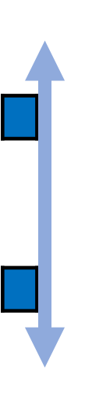
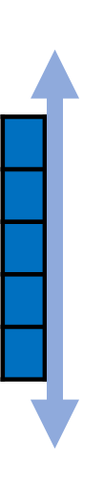
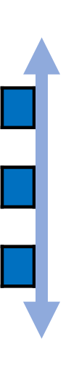
Existing Load Balancing Approaches
L7 per-request frontend proxy
NGINX
Clients
…
What if servers can migrate
live TCP connections?
➔ Strong load balancing system with
☒ Scalability
Stateful load balancing for
per-connection consistency (PCC)
Load balancing by switch
Switch
Per-packet distribution
SwitchKV [NSDI ‘16]
NetCache [SOSP ‘17]
Pegasus [OSDI ‘20]
L4 per-connection distribution
SilkRoad [SIGCOMM ‘17]
Beamer [NSDI ‘18]
Cheetah [NSDI ‘20]
…
☒ TCP support
☒ Balancing skewed workload
Notes:
In another direction, switch-based stateful load balancer like SilkRoad, Beamer, or Cheetah proposed per-connection distribution at layer 4.
In this approach,
the switch receives connection establishment requests from clients,
and distribute them to multiple backend servers.
The switch also maintains some state like connection table to ensure per-connection consistency or PCC, which means each connection flow is consistently forwarded to the same server for TCP support.
However, due to the PCC requirement,
this approach does not provide good load balancing guarantees for skewed workloads.
For example, if TCP connections to one of the servers happen to impose higher workload than other servers, it still causes server overload. Observing all these limitations, we ask
what if servers can migrate live TCP connections each other.

Slide 8
Existing Load Balancing Approaches
L7 per-request frontend proxy
NGINX
Clients
…
What if servers can migrate
live TCP connections?
➔ Strong load balancing systems with
☒ Scalability
Load balancing by switch
Switch
Per-packet distribution
SwitchKV [NSDI ‘16]
NetCache [SOSP ‘17]
Pegasus [OSDI ‘20]
L4 per-connection distribution
SilkRoad [SIGCOMM ‘17]
Beamer [NSDI ‘18]
Cheetah [NSDI ‘20]
✅ Scalability
✅ TCP support
✅ Balancing skewed workload
…
☒ TCP support
☒ Balancing skewed workload
Notes:
Then, we can enable a strong load balancing system including all these three properties, scalability, TCP support, and balancing skewed workload.

Slide 9
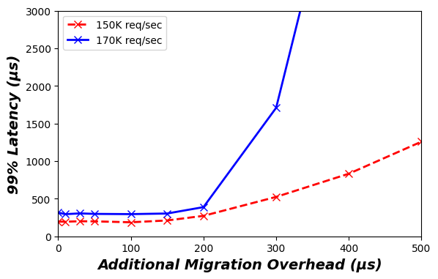
Disruptive or slow migration
can make things even worse
Retransmission
Timeout (ms-scale)
1
2
3
4
4
x
Drop?
Migration
Disruptive Migration
Slow Migration
Notes:
But TCP migration should be designed carefully, otherwise it can make things even worse.
Suppose a client is sending TCP requests to a server. If the connection is migrated around this time, the system should handle the 4th packet somehow, because the original server cannot handle it.
One way is to drop the packet in the network, but then the client should rely on the TCP retransmission timeout, which is ms-scale at least. It will make the tail latency even worse.
Another point is that migration itself is an additional overhead to the server.
This graph shows our measurement study result of tail latency depending on different migration overhead.
We triggers ten thousands of migrations between two HTTP servers during 10 seconds of runtime.
Fast migrations taking below 200 us maintains the tail latency nearly unchanged.
However, when the migration overhead becomes over 200us, tail latency starts to increase significantly.
Especially, this impact becomes even worse when the request rate is higher, because more requests are delayed during the migration.

Slide 10
All request traffic must go through the single sequencer
(Network Serialization)
☒ Network load imbalance ⇒ high latency
☒ Sequencer scalability bottleneck
☒ Prolonged sequencer failover
What if servers can migrate
a live TCP connection?
➔ Strong load balancing system with
Hydra
Use multiple sequencers concurrently
(Serialization-Free)
✅ Network load balancing ⇒ low latency (e.g., 13x)
✅ Higher scalability beyond a single sequencer
✅ Faster sequencer failover (e.g., 5x)
✅ Scalability
✅ TCP Support
✅ Balancing skewed workload
Notes:
In this talk, I will introduce our solution Hydra
which is a serialization-free network ordering protocol by using multiple sequencer concurrently.
Compared to existing approaches,
our system achieves network load balancing and 13 times lower latency
Higher scalability beyond a single sequencer,
And 5 times faster sequencer failover time

Slide 11

This Talk: Capybara
Design goal: 𝜇s-scale-fast and client-transparent TCP migration
“without disconnection or blocking”
User Space
Customized protocols
Two-phase protocol
Phase 1: Migration handshake to buffer the connection
Phase 2: Connection state transfer
Kernel-bypass
Library OS
Migration-aware
packet forwarding
Application
No context switch
Input
Match & Action
Table
Forwarding Decision
Kernel Space
NIC
Programmable Switch
RX/TX Queues
Kernel-bypassing OS
Transparently migrate a live TCP connection within single-digit 𝜇s
Notes:
So in this talk, we propose Capybara with our design goal of us-scale client-transparent TCP migration system.
Client-transparent here means capybara does not disconnect or block the connection.
Capybara is built on kernel-bypassing library OS.
It enables highly efficient TCP migration by removing context switching overheads.
Also, we carefully design customized two-phase protocol inside the library OS to achieve the client-transparent TCP migration.
Phase 1 performs migration handshake to temporarily buffer the connection, and phase 2 transfers the connection state. It will be discussed more later.
On top of that, Capybara leverages modern programmable switches which have reconfigurable match action tables in the data plane, to support dynamic migration-aware packet forwarding.
As a result, Capybara transparently migrate a live TCP connection within single-digit 𝜇s.

Slide 12
This Talk: Capybara
Kernel-bypassing userspace OS
  No context switching overheads
  Sophisticated protocol for seamless migrations
Programmable Switch
  Migration-aware dynamic packet forwarding
➔ Transparently migrate a live TCP connection in a single-digit 𝜇s
Notes:
And in this talk, I will introduce our solution, Capybara, which is a live TCP migration system.
Capybara is built on a kernel-bypassing usespace OS,

Slide 13
Outline
Introduction
Capybara Design
Example Workflow
Preliminary Evaluation
Notes:
Then, let us discuss the Capybara design in more details

Slide 14
Naïve approach can reset the connection
Origin (S0)
Switch
Target (S1)
REDIRECT
C0
Export
C0-S0
Switch
No one has connection state
RST!
REDIRECT
RST!
C0-S1
Import
C0-S0
C0-S0
C0-S1
S0
S1
Origin
Target
Notes:
As we discussed, TCP migration should be designed carefully. Let me show you the technical challenges.
Here, we have two servers S0 and S1, one client C0, and the switch at the middle. The switch can be either virtual software switch or physical programmable switch.
At the beginning, C0 establishes a TCP connection with S0, and the switch is forwarding the packets to S0.
And then, S0 is trying to migrate this connection to S1.
That is , S0 is the origin and S1 is the target of this migration.
Before and after the migration, the switch should forward packets to the server who currently has the connection state. However, it’s not trivial to achieve.
In this timeline, S0 exports the connection state at this time, send it to S1, then S1 imports it using linux feature like TCP_REPAIR.
For this, the servers should inform the switch at some point, so that it can start to forward request packets to S1 instead of S0.
For example, let’s say S0 sends REDIRECT signal to the switch before it exports the connection state.
In this case, if the switch receives a request message at this time, it will be forwarded to S1, before S1 receives the connection state.
Once this packet is delivered, S1 would generate the RST packet to the client and reset the connection.
Similarly, if S0 signals the switch after it sends the connection state, client requests received by the switch at this time will be delivered to S0 and reset the connection similarly.
So essentially, there is a small time-window that both S0 and S1 do not have the connection state,
meaning that the client requests shouldn’t be delivered to either of them.

Slide 15

Block the connection during migration?
Prism [NSDI ‘21]
Origin (S0)
Switch
Target (S1)
BLOCK
C0
Export
C0-S0
Switch
Block the connection
(drop packets)
OPEN & REDIRECT
C0-S1
Import
C0-S0
C0-S1
S0
S1
Origin
Target
Notes:
To solve this problem, a recent work Prism published in NSDI ’21 proposed a TCP migration relying on the switch to block the connection during migration.
In this same setup, Prism sends a BLOCK signal from the origin server to the switch first, and exports the connection state only after the BLOCK signal is acknowledged by the switch.
And then, after the target server imports the connection state, it sends a OPEN & REDIRECT signal to the switch.
Using this approach, the connection is blocked during this time, meaning that all request packets are dropped by the switch, and the servers can perform the migration without worrying about the connection reset problem.
As you can see, this protocol is obviously safe, but as we discussed before, dropping all packets during the migration causes client timeout, which is not acceptable for many us-scale data center applications.

Slide 16
Our Approach: Transient Packet Buffering
Origin (S0)
Switch
Target (S1)
PREPARE_MIG
C0
Export
PREPARE_MIG_ACK & REDIRECT
Capybara migrates TCP connections without blocking
C0-S0
Buffer the connection
C0
Switch
Merge
C0-S1
Import
C0-S0
C0-S1
S0
S1
Origin
Target
Notes:
So instead of blocking the connection, we transiently buffer the packets during the migration, and process them after the migration is complete.
In the same setup, the origin sends PREPARE_MIG message to the target first.
Once receiving this PREPARE_MIG, the Target prepares a temporary buffer to hold packets from the connection to be migrated.
Then, it sends back PREPARE_MIG_ACK message together with REDIRECT signal.
And the switch starts to redirect packets since it receives the REDIRECT signal. For example, if it receives a packet at this time, it will be forwarded to the target, and the target will buffer this packet.
Then, once the origin server receives the PREPARE_MIG_ACK, it sends the connection state to the target server.
Once the target server receives the connection state, it merges the temporary buffer into the connection state, and start to serve the connection. So the packets are buffered during this time, instead of blocking.
Using this approach, Capybara achieves TCP migration without blocking the connection.

Slide 17
Our Approach: Transient Packet Buffering
Origin (S0)
Switch
Target (S1)
PREPARE_MIG
C0
Export
PREPARE_MIG_ACK & REDIRECT
Capybara migrates TCP connections without blocking
C0-S0
Buffer the connection
C0
Switch
Merge
C0-S1
Import
C0-S0
C0-S1
S0
S1
Origin
Target
Notes:
So instead of blocking the connection, we transiently buffer the packets during the migration, and process them after the migration is complete.
In the same setup, the origin sends PREPARE_MIG message to the target first.
Once receiving this PREPARE_MIG, the Target prepares a temporary buffer to hold packets from the connection to be migrated.
Then, it sends back PREPARE_MIG_ACK message together with REDIRECT signal.
And the switch starts to redirect packets since it receives the REDIRECT signal. For example, if it receives a packet at this time, it will be forwarded to the target, and the target will buffer this packet.
Then, once the origin server receives the PREPARE_MIG_ACK, it sends the connection state to the target server.
Once the target server receives the connection state, it merges the temporary buffer into the connection state, and start to serve the connection. So the packets are buffered during this time, instead of blocking.
Using this approach, Capybara achieves TCP migration without blocking the connection.

Slide 18
Server Architecture
User
Space
Application
Kernel
Space
TCP
NIC Driver
HW
NIC
Standard (Linux-based) Server
Notes:
Then let me go through Capybara system architecture in more details.
First, server architecture.
A standard linux-based server is like this.
In the kernel space, it has the NIC driver and network stack supporting standard TCP protocol, and then server application is running on top of that in the user space.

Slide 19
Server Architecture
Implements TCP migration protocol in Demikernel LibOS [SOSP ‘21]
TCP
Tracking TCP receive queue length
TCP state serialization/deserialization
TCPMig
Manage ongoing migration instances
Transient packet buffering
User
Space
Application
TCP
TCPMig
LibOS
DPDK (rte_mempool & PMD)
HW
NIC
Capybara Server
Notes:
Instead of this standard server architecture, Capybara leverages recent kernel-bypassing library OS architecture called Demikernel.
Demikernel is a userspace library OS supporting standard TCP stack implementation. It provides a standardized I/O APIs accommodating different types of kernel-bypass techniques such as DPDK.
Inside the network stack, Capybara has some additional supports on top of the standard TCP stack, such as tracking TCP recv_queue length and TCP state serialization logic for migration.
Also, we add a customized Layer 4 protocol called TCPMig, to manage ongoing migration instance and transient packet buffer for that.

Slide 20
TCP
TCPMig
Notes:
So, each server in the Rack is running this Capybara network stack in the user space.

Slide 21
Switch Architecture
Migration-aware packet forwarding
Server-load-aware migration
Migration Directory | Origin | Target
Client | Origin | Target
Minimum Workload
Server | Workload
S0 | 0
TCP
TCPMig
TCP
TCPMig
HEARTBEAT
Workload: 0
HEARTBEAT
Workload: 0
S0
S1
Notes:
Next, switch architecture. Current Capybara design relies on the Top of Rack switch of the servers.
The switch provides two important features of Capybara.
First, Migration aware packet forwarding. For this, the switch maintains a lookup table called migration directory in the data plane register.
Migration directory stores a mapping of each migrated connection and the origin and target server of the migration, which is used to redirect packets accordingly.
Second, server-load-aware migration. For this, the switch maintains another register called minimum workload. When a connection is migrated, ideally the target server should be the minimum-loaded server for the best load balancing.
So, each capybara server periodically sends a HEARTBEAT message with it’s current workload.
And then, the switch tracks the minimum-loaded server and it’s current workload using the minimum workload register.

Slide 22
Network Ordering
C0
Migration Directory | Origin | Target
Client | Origin | Target
Minimum Workload
Server | Workload
S0 | 0
TCP
TCPMig
TCP
TCPMig
HEARTBEAT
Workload: 0
HEARTBEAT
Workload: 0
S0
S1
Notes:
Then, let us go thorough a simple example to see how the TCP migration works in Capybara.
At the beginning, there is no TCP connections on both servers, and they inform the switch of the current workload 0 by the periodic HEARTBEAT message.
The switch records one of them into the minimum workload register.
Then, a client C0 establishes a TCP connection with S0 first.

Slide 23
Outline
Introduction
Capybara Design
Example Workflow
Preliminary Evaluation
Notes:
Then, let me show you an example workflow of capybara.

Slide 24
Tracking Server Workload
C0
C1
Migration Directory | Origin | Target
Client | Origin | Target
Minimum Workload
Server | Workload
S0 | 0
TCP
TCPMig
TCP
TCPMig
HEARTBEAT
Workload: 0
HEARTBEAT
Workload: 0
S0
S1
Notes:
In this example, we have two client C0 and C1.
At the beginning, there is no TCP connections on servers, and they inform the switch of the current workload 0 by sending a HEARTBEAT message.
The switch records one of them into the minimum workload register.

Slide 25
Initial Connection Establishment
Workflow:
Establish connection
Initiate migration
Prepare migration
Transfer connection state
C0
C1
Migration Directory | Origin | Target
Client | Origin | Target
Minimum Workload
Server | Workload
S0 | 0
TCP
TCPMig
TCP
TCPMig
0
0
C0
C1
S0
S1
Notes:
Next, both clients establish a TCP connection to S0,
and the TCP stack of S0 has the recv_queue for each connection.

Slide 26
Initial Connection Establishment
Workflow:
Establish connection
Initiate migration
Prepare migration
Transfer connection state
C0
C1
Migration Directory | Origin | Target
Client | Origin | Target
Minimum Workload
Server | Workload
S0 | 0
TCP
TCPMig
TCP
TCPMig
HEARTBEAT
Workload: 5
HEARTBEAT
Workload: 0
3
2
C0
C1
S0
S1
Notes:
At the beginning, the clients request rate is not too high, so the number of requests in the TCP recv_queue is also small.
Then, the servers send the heartbeat message again with the current workload, and the minimum workload register value is updated to S1.

Slide 27
Server Overload
Initial Connection Establishment
Workflow:
Establish connection
Initiate migration
Prepare migration
Transfer connection state
C0
C1
Migration Directory | Origin | Target
Client | Origin | Target
Minimum Workload
Server | Workload
S1 | 0
TCP
TCPMig
TCP
TCPMig
HEARTBEAT
Workload: 5
HEARTBEAT
Workload: 0
3
2
C0
C1
S0
S1
Notes:
After some time, the workload from clients are increased,

Slide 28
Server Overload
Workflow:
Establish connection
Initiate migration
Prepare migration
Transfer connection state
C0
C1
Migration Directory | Origin | Target
Client | Origin | Target
Minimum Workload
Server | Workload
S1 | 0
TCP
TCPMig
TCP
TCPMig
17
15
C0
C1
S0
S1
Notes:
so more request messages are queueing up in the TCP recv-queue of S0.

Slide 29
Server Overload
Workflow:
Establish connection
Initiate migration
Prepare migration
Transfer connection state
C0
C1
Migration Directory | Origin | Target
Client | Origin | Target
Minimum Workload
Server | Workload
S1 | 0
TCP
TCPMig
TCP
TCPMig
17
15
Workload > 30
C1
C0
C1
S0
S1
Notes:
Once the total recv_queue length becomes bigger than a certain threshold, for example 30 here, TCPMig stack selects a connection, for example C1 here, and starts the migration.

Slide 30
Phase 1: Prepare Migration
Workflow:
Establish connection
Initiate migration
Prepare migration (buffer)
Transfer connection state
C0
C1
Migration Directory | Origin | Target
Client | Origin | Target
Minimum Workload
Server | Workload
S1 | 0
TCP
TCPMig
PREPARE_MIG
Origin: S0
Conn: C1
Target: S1
TCP
TCPMig
PREPARE_MIG
Origin: S0
Conn: C1
17
15
Workload > 30
C1
C0
C1
S0
S1
C1
Notes:
First, it sends PREPARE_MIGRATION message to the switch, saying that I'm S0 and want to migrate connection C1.
Once receiving this PREPARE_MIGRATION, the switch checks the minimum workload register, write the server address as the target of this migration, and then forward it to the target server.
Then, the target server prepares the temporary buffer for connection C1 in the TCPMig stack,

Slide 31
Phase 1: Prepare Migration
Workflow:
Establish connection
Initiate migration
Prepare migration (buffer)
Transfer connection state
C0
C1
Migration Directory | Origin | Target
Client | Origin | Target
Minimum Workload
Server | Workload
S1 | 0
TCP
TCPMig
PREPARE_MIG_ACK
Origin: S0
Conn: C1
Target: S1
TCP
TCPMig
17
15
C1
C0
C1
S0
S1
C1
Notes:
After then it sends back the PREPARE_MIG_ACK message to the switch.

Slide 32
Phase 1: Prepare Migration
Workflow:
Establish connection
Initiate migration
Prepare migration (buffer)
Transfer connection state
C0
C1
Migration Directory | Origin | Target
Client | Origin | Target
C1 | S0 | S1
Minimum Workload
Server | Workload
S1 | 0
TCP
TCPMig
PREPARE_MIG_ACK
Origin: S0
Conn: C1
Target: S1
PREPARE_MIG_ACK
Origin: S0
Conn: C1
Target: S1
TCP
TCPMig
17
15
C1
C0
C1
S0
S1
C1
Notes:
Once the switch receives the PREPARE_MIG_ACK, it means that the target server is ready to buffer the packets from this connection,
so switch writes a new entry in the migration directory that connection c1 is being migrated from S0 to S1, and then starts to redirect packets from C1 to S1 instead of S0.
And then switch forwards the PREPARE_MIG_ACK message to the origin server.

Slide 33
Transient Request Buffering
Workflow:
Establish connection
Initiate migration
Prepare migration (buffer)
Transfer connection state
C0
C1
Src: C1
Dst: S0
Migration Directory | Origin | Target
Client | Origin | Target
C1 | S0 | S1
Minimum Workload
Server | Workload
S1 | 0
TCP
TCPMig
PREPARE_MIG_ACK
Origin: S0
Conn: C1
Target: S1
TCP
TCPMig
17
15
C1
C0
C1
S0
S1
C1
Notes:
So from this moment, if the switch receives a TCP packet, for example request from C1 to S0,

Slide 34
Transient Request Buffering
Workflow:
Establish connection
Initiate migration
Prepare migration (buffer)
Transfer connection state
C0
C1
Src: C1
Dst: S0
Migration Directory | Origin | Target
Client | Origin | Target
C1 | S0 | S1
Minimum Workload
Server | Workload
S1 | 0
TCP
TCPMig
PREPARE_MIG_ACK
Origin: S0
Conn: C1
Target: S1
TCP
TCPMig
Src: C1
Dst: S1
17
15
1
C1
C0
C1
S0
S1
C1
Notes:
it checks the migration directory, and rewrite the destination address to be the target server before forwarding.
Then, the target server stores this packet into the corresponding packet buffer in the TCPMig stack.

Slide 35
Workflow:
Establish connection
Initiate migration
Prepare migration (buffer)
Transfer connection state
C0
C1
Migration Directory | Origin | Target
Client | Origin | Target
C1 | S0 | S1
Minimum Workload
Server | Workload
S1 | 0
TCP
TCPMig
PREPARE_MIG_ACK
Origin: S0
Conn: C1
Target: S1
TCP
TCPMig
17
15
1
C1
C0
C1
S0
S1
C1
Notes:
Next, once the origin server receives PREPARE_MIG_ACK,

Slide 36
Phase 2: State Transfer
Workflow:
Establish connection
Initiate migration
Prepare migration (buffer)
Transfer connection state
C0
C1
Migration Directory | Origin | Target
Client | Origin | Target
C1 | S0 | S1
Minimum Workload
Server | Workload
S1 | 0
TCP
TCPMig
CONN_STATE
Origin: S0
Target: S1
CONN_STATE
Origin: S0
Target: S1
TCP
TCPMig
17
15
15
1
C1
C1
Serialize
C1
Merge
C0
C1
S0
S1
C1
C1
Notes:
It serializes the connection state including the recv-queue, and passes it to the TCPMig stack.
Then, TCPMig stack creates a CONN_STATE message including the serialized state as the payload, and sends it to the target server.
Once receiving the CONN_STATE message, the target server deserializes the connection state, merges the temporary buffer for the connection into the state, and then import it into the TCP stack.
Q.

Slide 37
Rewriting Response Header
Workflow:
Establish connection
Initiate migration
Prepare migration (buffer)
Transfer connection state
C0
C1
Src: S0
Dst: C1
Migration Directory | Origin | Target
Client | Origin | Target
C1 | S0 | S1
Minimum Workload
Server | Workload
S1 | 0
TCP
TCPMig
TCP
TCPMig
Src: S1
Dst: C1
17
15
16
C0
S0
S1
C1
Notes:
Now the migration is done, and S1 starts to process the request in the recv_queue of connection C1 and sends response.
Once the switch receives the response packet, it checks the migration directory, and rewrite the source address to be the origin server before forwarding, so that the client is transparent of the migration happening across servers.

Slide 38
Outline
Introduction
Capybara Design
Example Workflow
Preliminary Evaluation
Notes:
This is how Capybara works. Then, let me show you a preliminary evaluation result and wrap up this talk.

Slide 39
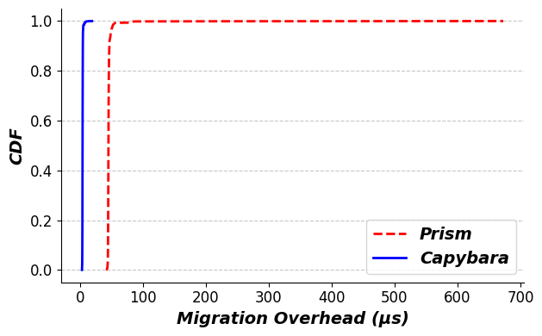
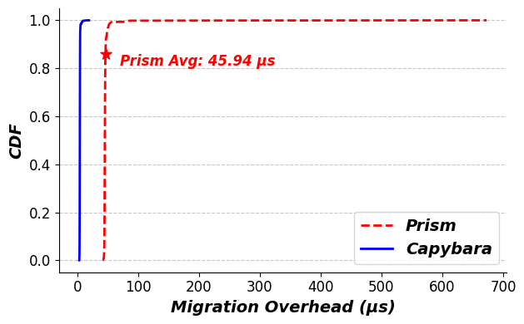
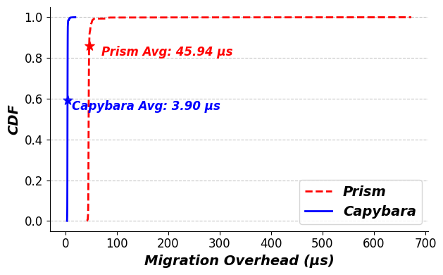
Capybara enables stable and low
migration overhead
Setup
Two servers
One TCP client
10,000 migrations
Prism (Linux-based)
Avg: 45.94 𝜇s
Tail latency over 600 𝜇s
Capybara
Avg: ~ 3.90 𝜇s (12x faster)
Stable
Capybara provides a promising TCP migration solution
for 𝜇s-scale data center systems
* Blocking
* Non-blocking
Notes:
We show that Capybara enables stable and low migration overhead.
For this, we run two servers and one client, and measure the migration overheads on the server for ten thousands times.
This graph shows the distribution of total server overhead for each migration.
Using a linux kernel based approach, Prism takes about 40 to 50 us for a single migration in average.
Moreover, the result shows that the linux-based approach have long tail latency over hundreds of us because it’s vulnerable to various system interferences like context switching or scheduling delays.
On the other hand, Capybara incurs only about 4 us of server overheads by taking the advantage of kernel-bypassing network stack.
Capybara also avoid the system interferences by integrating all network stack operations like TCP state serialization into the user space, so it achieves highly stable migration overhead.
Also note that Prism requires to block the connection during the migration, while Capybara achieves it without blocking.
These results demonstrate that Capybara provides a promising TCP migration solution for us-scale data center systems.

Slide 40
Conclusion
TCP migration is a promising load balancing solution for data center applications
However, disruptive or slow TCP migration is not suitable for 𝜇s-scale service-level objective
Capybara co-designs kernel-bypassing OS and programmable switches, and provides a client-transparent single-digit-𝜇s live TCP migration solution
Notes:
In conclusion, TCP migration is a promising approach to solve the server overload issue in data centers, which is a critical challenge for data center applications
However, existing disruptive or slow TCP migration is not suitable for 𝜇s-scale service-level objective.
Capybara, ...

Slide 41
Future Work
Explore more various and realistic load balancing policies
Evaluate some real-world applications on Capybara under various workload patterns
Extend the system to support more generalized environments (e.g., industry standard TLS, multi-rack scale systems)
Notes:
For our future work, our current load balancing policy is simple, so we plan to explore more various and realistic load balancing policies
Also, we will evaluate some real-world applications like Redis on Capybara under various workload patterns, to demonstrate the performance benefit.
Lastly, Capybara currently assumes a single-rack-scale TCP servers. We plan to extend the system to support more generalized environments, such as industry standard TLS or multi-rack scale systems.

Slide 42
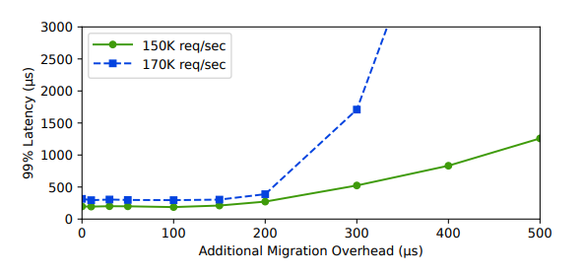

Slide 43
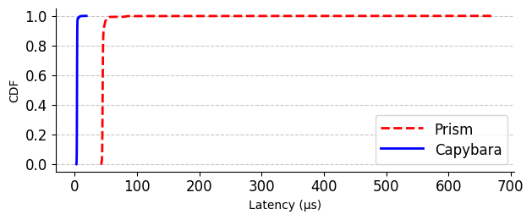

Slide 44
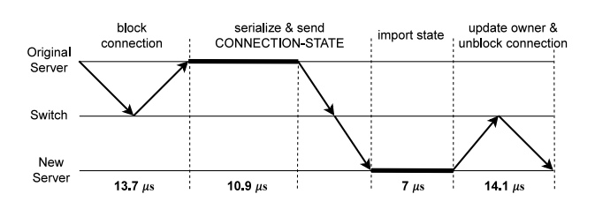
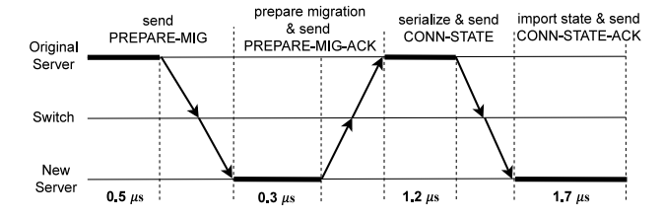
Notes:
To evaluate the performance benefit of Capybara, we measure the migration overhead and compare it to the Prism which is a linux kernel based TCP migration system.
Using Prism, the origin server communicates with the switch to block the connection first. This step takes about 13 us.
Then, it serializes and sends the connection state to the target server, This step takes about 10 us.
Next, target server imports the received connection state

Slide 46
Challenge 1: TCP state tracking
Application
LibOS
Network Stack
recv_q_len:
Step: X
…
SW
(userspace)
HW
NIC
S1
Notes:
Then, let me explain our server architecture.
In the network stack, we have the standard TCP stack, and our TCPMig stack for the migration support.

Slide 47
Challenge 1: TCP state tracking
Application
LibOS
Network Stack
recv_q_len:
1100
Step: X
…
SW
(userspace)
HW
NIC
S1
Notes:
Then, let me explain our server architecture.
In the network stack, we have the standard TCP stack, and our TCPMig stack for the migration support.

Slide 48
Challenge 1: TCP state tracking
User
Space
Application
Kernel
Space
TCP
C0
…
Packet
Buffer
HW
NIC
Notes:
The application needs to track the tcp state during the tcp migration.
For one example, the application will send the connection state to the target server.
Then, it first needs to ensure that the socket is completely destructed in the kernel, so that it does not transmit any packets further.

Slide 49
A
B
C

Slide 50
Migration Directory
Minimum Workload
Server: C
Value: 20
A
B
C

Slide 51
C0
C1
Key (Client IP:Port) | Value 1 (Origin IP:Port) | Value 2 (Target IP:Port)
Frontend
S1
S0

Slide 52
C0
C1
Key (Client IP:Port) | Value (Server IP:Port)
C0:10000 | S0:80
Frontend
S1
S0

Slide 53
Network Ordering
to Eliminate Coordination
C0
C1
Migration Directory
Key (Client IP:Port) | Value (Server IP:Port)
Minimum Workload
27 (S1)
Frontend
S0
S1

Slide 54
Network Ordering
C0
C1
C1
Migration Directory
Key (Client Socket) | Value (Server Socket)
Minimum Workload
S0
S1
Notes:
Then, let me show you how Capybara works with an example.
Here, we have two backend servers S0 and S1, and their frontend server. These servers are connected by the ToR switch, which is implementing the Capybara data plane algorithm.
That is, its maintaining the minimum workload register, and the migration directory which is mapping each migrated connection to the current server.

Slide 55
Network Ordering
C0
C1
C2
SYN
Src: C0
Dst: FE
Frontend
(FE)
Migration Directory
Key (Client Socket) | Value (Server Socket)
Minimum Workload
PREPARE_MIG_ACK
Origin: S0
Target: S1
S0
S1
Notes:
Then, let me show you how Capybara works with an example.
Here, we have two backend servers S0 and S1, and their frontend server. These servers are connected by the ToR switch, which is implementing the Capybara data plane algorithm.
That is, its maintaining the minimum workload register, and the migration directory which is mapping each migrated connection to the current server.

Slide 56
Network Ordering
C0
C1
C2
Frontend
(FE)
Migration Directory
Key (Client Socket) | Value (Server Socket)
Minimum Workload
HEARTBEAT
Workload: 0
HEARTBEAT
Workload: 0
S0
S1
Notes:
Then, let me show you how Capybara works with an example.
Here, we have two backend servers S0 and S1 and three clients C0, C1, and C2.
The servers are connected by the Capybara switch, which is acting as the frontend server as well.
To support the TCP migration, the switch maintains two data structures. One is the Minimum workload register, and the other one is the migration directory which is mapping each client socket to the current server socket.
At the beginning there is no established connections yet. Each server is periodically sending a HEARTBEAT message to inform the switch of it’s current workload, which is 0 at this moment.

Slide 57
Network Ordering
C0
C1
C2
Frontend
(FE)
Migration Directory
Key (Client Socket) | Value (Server Socket)
Minimum Workload
Server | Workload
HEARTBEAT
Workload: 0
HEARTBEAT
Workload: 0
S0
S1
Notes:
Then, let me show you how Capybara works with an example.
Here, we have two backend servers S0 and S1 and three clients C0, C1, and C2.
The servers are connected by the Capybara switch, which is acting as the frontend server as well.
To support the TCP migration, the switch maintains two data structures. One is the Minimum workload register, and the other one is the migration directory which is mapping each client socket to the current server socket.
At the beginning there is no established connections yet. Each server is periodically sending a HEARTBEAT message to inform the switch of it’s current workload, which is 0 at this moment. On receiving the HEARTBEAT messages, the switch update the minimum workload register accordingly. Here, both of them have the same workload 0, and the register value is updated to

Slide 58
Network Ordering
C0
C1
C2
Frontend (FE)
Migration Directory
Key (Client Socket) | Value (Server Socket)
Minimum Workload
Server | Workload
HEARTBEAT
Workload: 0%
HEARTBEAT
Workload: 0%
S0
S1
Notes:
Then, let me show you how Capybara works with an example.
Here, we have two backend servers S0 and S1 and three clients C0, C1, and C2.
The servers are connected by the Capybara switch, which is acting as the frontend server as well.
To support the TCP migration, the switch maintains two data structures. One is the Minimum workload register, and the other one is the migration directory which is mapping each client socket to the current server socket.
At the beginning there is no established connections yet. Each server is periodically sending a HEARTBEAT message to inform the switch of it’s current workload, which is 0 at this moment. On receiving the HEARTBEAT messages, the switch update the minimum workload register accordingly. Here, both of them have the same workload 0, and the register value is updated to

Slide 59
Network Ordering
C0
C1
C2
SYN
Src: C0
Dst: FE
Frontend (FE)
Migration Directory
Key (Client Socket) | Value (Server Socket)
Minimum Workload
Server | Workload
S0 | 0%
HEARTBEAT
Workload: 0%
HEARTBEAT
Workload: 0%
S0
S1
Notes:
Then, let me show you how Capybara works with an example.
Here, we have two backend servers S0 and S1 and three clients C0, C1, and C2.
The servers are connected by the Capybara switch, which is acting as the frontend server as well.
To support the TCP migration, the switch maintains two data structures. One is the Minimum workload register, and the other one is the migration directory which is mapping each client socket to the current server socket.
At the beginning there is no established connections yet. Each server is periodically sending a HEARTBEAT message to inform the switch of it’s current workload, which is 0 at this moment. On receiving the HEARTBEAT messages, the switch update the minimum workload register accordingly. Here, both servers have the same workload 0, and the register value is updated to S0 and 0.
Then, clients start to establish the TCP connection to the system.

Slide 60
Network Ordering
C0
C1
C2
SYN
Src: C0
Dst: FE
Frontend (FE)
Migration Directory
Key (Client Socket) | Value (Server Socket)
Minimum Workload
Server | Workload
S0 | 0%
S0
S1
Notes:
Then, let me show you how Capybara works with an example.
Here, we have two backend servers S0 and S1 and three clients C0, C1, and C2.
The servers are connected by the Capybara switch, which is acting as the frontend server as well.
To support the TCP migration, the switch maintains two data structures. One is the Minimum workload register, and the other one is the migration directory which is mapping each client socket to the current server socket.
At the beginning there is no established connections yet. Each server is periodically sending a HEARTBEAT message to inform the switch of it’s current workload, which is 0 at this moment. On receiving the HEARTBEAT messages, the switch update the minimum workload register accordingly. Here, both servers have the same workload 0, and the register value is updated to S0 and 0.
Then, clients start to establish the TCP connection to the system.

Slide 61
Network Ordering
C0
C1
C2
SYN
Src: C0
Dst: FE
Frontend (FE)
Migration Directory
Key (Client Socket) | Value (Server Socket)
C0 | S0
Minimum Workload
Server | Workload
S0 | 0%
SYN
Src: C0
Dst: S0
S0
S1
Notes:
Then, let me show you how Capybara works with an example.
Here, we have two backend servers S0 and S1 and three clients C0, C1, and C2.
The servers are connected by the Capybara switch, which is acting as the frontend server as well.
To support the TCP migration, the switch maintains two data structures. One is the Minimum workload register, and the other one is the migration directory which is mapping each client socket to the current server socket.
At the beginning there is no established connections yet. Each server is periodically sending a HEARTBEAT message to inform the switch of it’s current workload, which is 0 at this moment. On receiving the HEARTBEAT messages, the switch update the minimum workload register accordingly. Here, both servers have the same workload 0, and the register value is updated to S0 and 0.
Then, clients start to establish the TCP connection to the system.

Slide 62
Network Ordering
C0
C1
C2
SYN/ACK
Src: FE
Dst: C0
Frontend (FE)
Migration Directory
Key (Client Socket) | Value (Server Socket)
C0 | S0
Minimum Workload
Server | Workload
S0 | 0%
SYN/ACK
Src: S0
Dst: C0
S0
S1
Notes:
Then, let me show you how Capybara works with an example.
Here, we have two backend servers S0 and S1 and three clients C0, C1, and C2.
The servers are connected by the Capybara switch, which is acting as the frontend server as well.
To support the TCP migration, the switch maintains two data structures. One is the Minimum workload register, and the other one is the migration directory which is mapping each client socket to the current server socket.
At the beginning there is no established connections yet. Each server is periodically sending a HEARTBEAT message to inform the switch of it’s current workload, which is 0 at this moment. On receiving the HEARTBEAT messages, the switch update the minimum workload register accordingly. Here, both servers have the same workload 0, and the register value is updated to S0 and 0.
Then, clients start to establish the TCP connection to the system.

Slide 63
Network Ordering
C0
C1
C2
ACK
Src: C0
Dst: FE
Frontend (FE)
Migration Directory
Key (Client Socket) | Value (Server Socket)
C0 | S0
Minimum Workload
Server | Workload
S0 | 0%
ACK
Src: C0
Dst: S0
S0
S1
Notes:
Then, let me show you how Capybara works with an example.
Here, we have two backend servers S0 and S1 and three clients C0, C1, and C2.
The servers are connected by the Capybara switch, which is acting as the frontend server as well.
To support the TCP migration, the switch maintains two data structures. One is the Minimum workload register, and the other one is the migration directory which is mapping each client socket to the current server socket.
At the beginning there is no established connections yet. Each server is periodically sending a HEARTBEAT message to inform the switch of it’s current workload, which is 0 at this moment. On receiving the HEARTBEAT messages, the switch update the minimum workload register accordingly. Here, both servers have the same workload 0, and the register value is updated to S0 and 0.
Then, clients start to establish the TCP connection to the system.

Slide 64
Network Ordering
C0
C1
C2
Frontend (FE)
Migration Directory
Key (Client Socket) | Value (Server Socket)
C0 | S0
Minimum Workload
Server | Workload
S0 | 0%
HEARTBEAT
Workload: 20%
HEARTBEAT
Workload: 0%
C0 (20%)
S0
S1
Notes:
Then, let me show you how Capybara works with an example.
Here, we have two backend servers S0 and S1 and three clients C0, C1, and C2.
The servers are connected by the Capybara switch, which is acting as the frontend server as well.
To support the TCP migration, the switch maintains two data structures. One is the Minimum workload register, and the other one is the migration directory which is mapping each client socket to the current server socket.
At the beginning there is no established connections yet. Each server is periodically sending a HEARTBEAT message to inform the switch of it’s current workload, which is 0 at this moment. On receiving the HEARTBEAT messages, the switch update the minimum workload register accordingly. Here, both servers have the same workload 0, and the register value is updated to S0 and 0.
Then, clients start to establish the TCP connection to the system.

Slide 65
Network Ordering
C0
C1
C2
Frontend (FE)
Migration Directory
Key (Client Socket) | Value (Server Socket)
C0 | S0
Minimum Workload
Server | Workload
S1 | 0%
HEARTBEAT
Workload: 20%
HEARTBEAT
Workload: 0%
C0 (20%)
S0
S1
Notes:
Then, let me show you how Capybara works with an example.
Here, we have two backend servers S0 and S1 and three clients C0, C1, and C2.
The servers are connected by the Capybara switch, which is acting as the frontend server as well.
To support the TCP migration, the switch maintains two data structures. One is the Minimum workload register, and the other one is the migration directory which is mapping each client socket to the current server socket.
At the beginning there is no established connections yet. Each server is periodically sending a HEARTBEAT message to inform the switch of it’s current workload, which is 0 at this moment. On receiving the HEARTBEAT messages, the switch update the minimum workload register accordingly. Here, both servers have the same workload 0, and the register value is updated to S0 and 0.
Then, clients start to establish the TCP connection to the system.

Slide 66
Network Ordering
C0
C1
C2
Frontend (FE)
Migration Directory
Key (Client Socket) | Value (Server Socket)
C0 | S0
C1 | S1
Minimum Workload
Server | Workload
S0 | 20%
C0 (20%)
C1 (30%)
S0
S1
Notes:
Then, let me show you how Capybara works with an example.
Here, we have two backend servers S0 and S1 and three clients C0, C1, and C2.
The servers are connected by the Capybara switch, which is acting as the frontend server as well.
To support the TCP migration, the switch maintains two data structures. One is the Minimum workload register, and the other one is the migration directory which is mapping each client socket to the current server socket.
At the beginning there is no established connections yet. Each server is periodically sending a HEARTBEAT message to inform the switch of it’s current workload, which is 0 at this moment. On receiving the HEARTBEAT messages, the switch update the minimum workload register accordingly. Here, both servers have the same workload 0, and the register value is updated to S0 and 0.
Then, clients start to establish the TCP connection to the system.

Slide 67

Network Ordering
C0
C1
C2
Frontend (FE)
Migration Directory
Key (Client Socket) | Value (Server Socket)
C0 | S0
C1 | S1
C2 | S0
Minimum Workload
Server | Workload
S1 | 30%
PREPARE_MIG
Origin: S0
Conn: C0
Target: S1
PREPARE_MIG
Origin: S0
Conn: C0
C2 (60%)
C0 (20%)
C1 (30%)
S0
S1
Notes:
Then, let me show you how Capybara works with an example.
Here, we have two backend servers S0 and S1 and three clients C0, C1, and C2.
The servers are connected by the Capybara switch, which is acting as the frontend server as well.
To support the TCP migration, the switch maintains two data structures. One is the Minimum workload register, and the other one is the migration directory which is mapping each client socket to the current server socket.
At the beginning there is no established connections yet. Each server is periodically sending a HEARTBEAT message to inform the switch of it’s current workload, which is 0 at this moment. On receiving the HEARTBEAT messages, the switch update the minimum workload register accordingly. Here, both servers have the same workload 0, and the register value is updated to S0 and 0.
Then, clients start to establish the TCP connection to the system.

Slide 68
Network Ordering
C0
C1
C2
Frontend (FE)
Migration Directory
Key (Client Socket) | Value (Server Socket)
C0 | S0
C1 | S1
C2 | S0
Minimum Workload
Server | Workload
S1 | 30%
PREPARE_MIG
Origin: S0
Conn: C0
Target: S1
MIG_Buffer (C0)
C2 (60%)
C0 (20%)
C1 (30%)
S0
S1
Notes:
Then, let me show you how Capybara works with an example.
Here, we have two backend servers S0 and S1 and three clients C0, C1, and C2.
The servers are connected by the Capybara switch, which is acting as the frontend server as well.
To support the TCP migration, the switch maintains two data structures. One is the Minimum workload register, and the other one is the migration directory which is mapping each client socket to the current server socket.
At the beginning there is no established connections yet. Each server is periodically sending a HEARTBEAT message to inform the switch of it’s current workload, which is 0 at this moment. On receiving the HEARTBEAT messages, the switch update the minimum workload register accordingly. Here, both servers have the same workload 0, and the register value is updated to S0 and 0.
Then, clients start to establish the TCP connection to the system.

Slide 69
Network Ordering
C0
C1
C2
Frontend (FE)
Migration Directory
Key (Client Socket) | Value (Server Socket)
C0 | S0
C1 | S1
C2 | S0
Minimum Workload
Server | Workload
S1 | 30%
PREPARE_MIG_ACK
Origin: S0
Conn: C0
Target: S1
MIG_Buffer (C0)
C2 (60%)
C0 (20%)
C1 (30%)
S0
S1
Notes:
Then, let me show you how Capybara works with an example.
Here, we have two backend servers S0 and S1 and three clients C0, C1, and C2.
The servers are connected by the Capybara switch, which is acting as the frontend server as well.
To support the TCP migration, the switch maintains two data structures. One is the Minimum workload register, and the other one is the migration directory which is mapping each client socket to the current server socket.
At the beginning there is no established connections yet. Each server is periodically sending a HEARTBEAT message to inform the switch of it’s current workload, which is 0 at this moment. On receiving the HEARTBEAT messages, the switch update the minimum workload register accordingly. Here, both servers have the same workload 0, and the register value is updated to S0 and 0.
Then, clients start to establish the TCP connection to the system.

Slide 70
Network Ordering
C0
C1
C2
Frontend (FE)
Migration Directory
Key (Client Socket) | Value (Server Socket)
C0 | S1
C1 | S1
C2 | S0
Minimum Workload
Server | Workload
S1 | 30%
PREPARE_MIG_ACK
Origin: S0
Conn: C0
Target: S1
MIG_Buffer (C0)
C2 (60%)
C0 (20%)
C1 (30%)
S0
S1
Notes:
Then, let me show you how Capybara works with an example.
Here, we have two backend servers S0 and S1 and three clients C0, C1, and C2.
The servers are connected by the Capybara switch, which is acting as the frontend server as well.
To support the TCP migration, the switch maintains two data structures. One is the Minimum workload register, and the other one is the migration directory which is mapping each client socket to the current server socket.
At the beginning there is no established connections yet. Each server is periodically sending a HEARTBEAT message to inform the switch of it’s current workload, which is 0 at this moment. On receiving the HEARTBEAT messages, the switch update the minimum workload register accordingly. Here, both servers have the same workload 0, and the register value is updated to S0 and 0.
Then, clients start to establish the TCP connection to the system.

Slide 71
Network Ordering
C0
C1
C2
Frontend (FE)
Migration Directory
Key (Client Socket) | Value (Server Socket)
C0 | S1
C1 | S1
C2 | S0
Minimum Workload
Server | Workload
S1 | 30%
PREPARE_MIG_ACK
Origin: S0
Conn: C0
Target: S1
PREPARE_MIG_ACK
Origin: S0
Conn: C0
Target: S1
MIG_Buffer (C0)
C2 (60%)
C0 (20%)
C1 (30%)
S0
S1
Notes:
Then, let me show you how Capybara works with an example.
Here, we have two backend servers S0 and S1 and three clients C0, C1, and C2.
The servers are connected by the Capybara switch, which is acting as the frontend server as well.
To support the TCP migration, the switch maintains two data structures. One is the Minimum workload register, and the other one is the migration directory which is mapping each client socket to the current server socket.
At the beginning there is no established connections yet. Each server is periodically sending a HEARTBEAT message to inform the switch of it’s current workload, which is 0 at this moment. On receiving the HEARTBEAT messages, the switch update the minimum workload register accordingly. Here, both servers have the same workload 0, and the register value is updated to S0 and 0.
Then, clients start to establish the TCP connection to the system.

Slide 72
Network Ordering
C0
C1
C2
Frontend (FE)
Migration Directory
Key (Client Socket) | Value (Server Socket)
C0 | S1
C1 | S1
C2 | S0
Minimum Workload
Server | Workload
S1 | 30%
CONN_STATE
Origin: S0
Conn: C0
Target: S1
CONN_STATE
Origin: S0
Conn: C0
Target: S1
MIG_Buffer (C0)
C2 (60%)
C0 (20%)
C0 (20%)
C1 (30%)
S0
S1
Notes:
Then, let me show you how Capybara works with an example.
Here, we have two backend servers S0 and S1 and three clients C0, C1, and C2.
The servers are connected by the Capybara switch, which is acting as the frontend server as well.
To support the TCP migration, the switch maintains two data structures. One is the Minimum workload register, and the other one is the migration directory which is mapping each client socket to the current server socket.
At the beginning there is no established connections yet. Each server is periodically sending a HEARTBEAT message to inform the switch of it’s current workload, which is 0 at this moment. On receiving the HEARTBEAT messages, the switch update the minimum workload register accordingly. Here, both servers have the same workload 0, and the register value is updated to S0 and 0.
Then, clients start to establish the TCP connection to the system.

Slide 73
Network Ordering
C0
C1
C2
Frontend (FE)
Migration Directory
Key (Client Socket) | Value (Server Socket)
C0 | S1
C1 | S1
C2 | S0
Minimum Workload
Server | Workload
S1 | 30%
CONN_STATE
Origin: S0
Conn: C0
Target: S1
CONN_STATE
Origin: S0
Conn: C0
Target: S1
MIG_Buffer (C0)
C2 (60%)
C0 (20%)
C0 (20%)
C1 (30%)
S0
S1
Notes:
Then, let me show you how Capybara works with an example.
Here, we have two backend servers S0 and S1 and three clients C0, C1, and C2.
The servers are connected by the Capybara switch, which is acting as the frontend server as well.
To support the TCP migration, the switch maintains two data structures. One is the Minimum workload register, and the other one is the migration directory which is mapping each client socket to the current server socket.
At the beginning there is no established connections yet. Each server is periodically sending a HEARTBEAT message to inform the switch of it’s current workload, which is 0 at this moment. On receiving the HEARTBEAT messages, the switch update the minimum workload register accordingly. Here, both servers have the same workload 0, and the register value is updated to S0 and 0.
Then, clients start to establish the TCP connection to the system.

Slide 74
Application
LibOS
Network Stack
TCP
TCPMig
S0
SW (userspace)
HW
NIC

Slide 75
Application
Application
LibOS
LibOS
Network Stack
Network Stack
TCP
TCPMig
TCP
TCPMig
SW (userspace)
SW (userspace)
HW
NIC
HW
NIC
S0
S1

Slide 76
Application
Application
LibOS
LibOS
Network Stack
Network Stack
TCP
TCPMig
TCP
TCPMig
SW (userspace)
SW (userspace)
HW
NIC
HW
NIC
S0
S1

Slide 77
Application
LibOS
Network Stack
LibOS
recv_q_len:
1100
Step: X
…
SW
(userspace)
HW
NIC
S0
S1
Notes:
Then, let me explain our server architecture.
In the network stack, we have the standard TCP stack, and our TCPMig stack for the migration support.

Slide 78
Challenge 1: TCP state tracking
Application
LibOS
Network Stack
recv_q_len:
1100
Step: X
…
SW
(userspace)
HW
NIC
S1
Notes:
Then let me go through our Capybara design
First, server architecture.
In the network stack, we have the standard TCP stack, and our TCPMig stack for the migration support.

