Slide 1
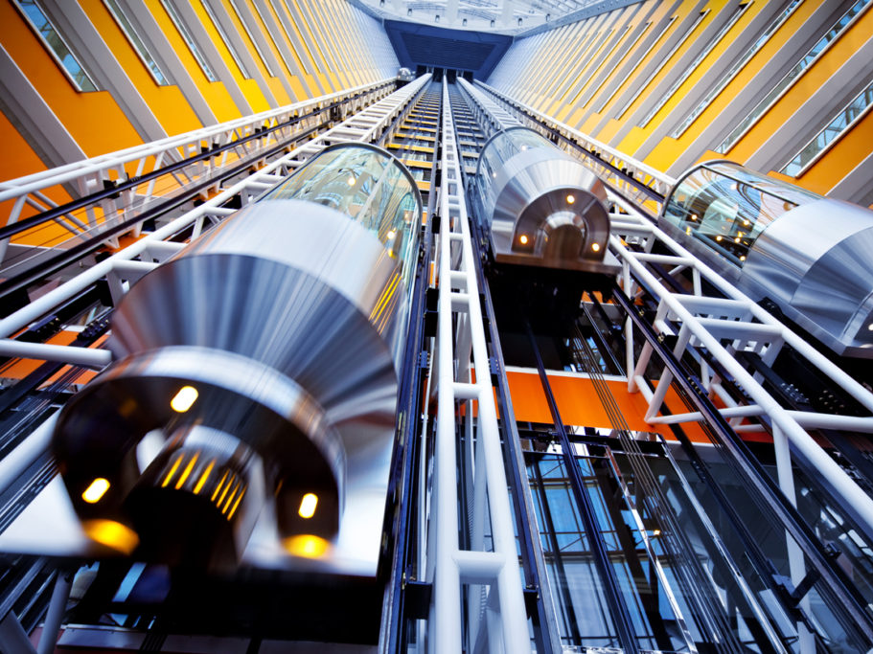
EleTrack Ultra-Low-Power Retrofitted Monitoring for Elevators
Mobashir Mohammad, Raj Joshi, Mun Choon Chan

Slide 2
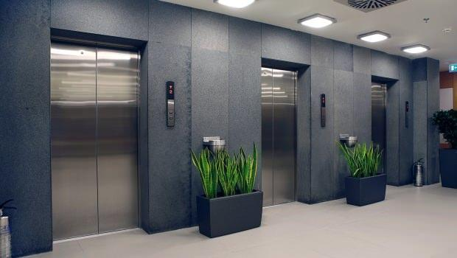
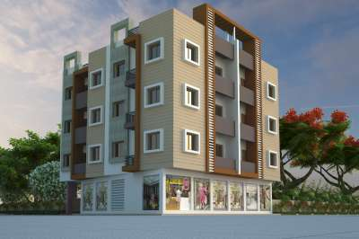
Elevators

Slide 3
Elevators
More than 4 million elevators
18 billion passenger trips per day
Notes:
Globally,

Slide 4
Elevators – Safety and Reliability
“Injuries from the use of elevators affect about 10,000 people each year.”
- US Consumer Product Safety Commission
Notes:
Here are some of the news headlines from just the previous month

Slide 5
Elevator Monitoring & Maintenance
Realtime Monitoring
Preemptive/Predictive
Maintenance
Key to improving elevator safety!
Notes:
Therefore, real time elevator monitoring leading to preemptive and even predictive maintenance is the key to …

Slide 6
New elevators with “smart” monitoring
Mel Eye™
E-Link™
REM®5.0

Slide 7
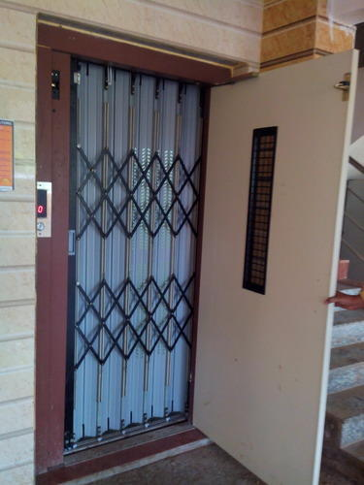
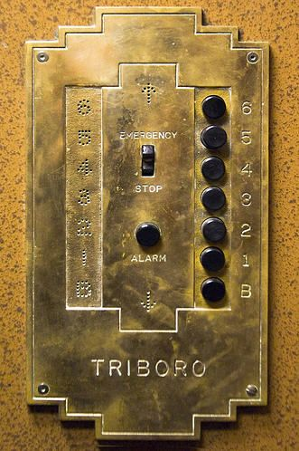
What about the existing elevators?
“The estimated elevator modernization market is about $13.92B globally.”
- Business Wire
Notes:
A significant proportion of existing elevators do not have smart monitoring features. Estimated …

Slide 8
EleTrack
Low Cost
Ultra-low Power
Readily Deployable
Our Vision
Notes:
In this paper we present EleTrack, which is a low cost, ultra-low power and readily deployable monitoring solution to retrofit existing elevators.

Slide 9
Retrofitting Challenges
1) Communication
Q. How do we get the sensor data out?
Option #1: Cabling
Hard to get it right
Increased cost + Maintenance downtime
Unreliable: risk of cable snapping, no easy way to repair
Monitoring Sensor
Device

Slide 10
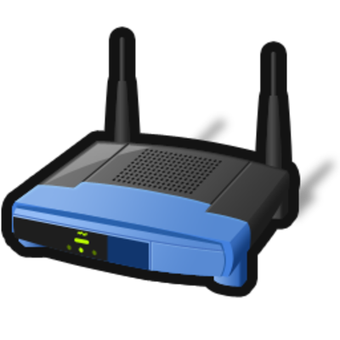
Retrofitting Challenges
1) Communication
Q. How do you get the sensor data out?
Option #2: Wireless Communication
WiFi, ZigBee and even 3G/LTE
Faraday Cage effect
Exception: Door Open + Same level
Reinforced
Concrete
Monitoring Sensor
Device
Multiple layers of steel
Notes:
The only exception is when … We will use this property in our design.

Slide 11
Retrofitting Challenges
2) Access to a power source
A power source may be available. But,
Lift maintenance fraternity: “Tampering with a running mechanical system is a bad idea.”
Security reasons, best to have the two systems isolated
Running electro-mechanical system
Network connected monitoring system
Maintenance downtimes + complicate installation and repair processes.
?
Desirable to have an ultra-low energy, battery powered solution!
Notes:
We want to power the monitoring device. Thus access to a power source. While some form of power is usually available in most elevator cabins, our discussions with many elevator operators revealed that it is not a good idea to tamper with the electrical system of a running mechanical system.

Slide 12
Retrofitting Challenges
3) Eliminate the need for calibration
Generally applicable
Readily Deployable
Notes:
It is thus desirable to eliminate any calibration required in the system

Slide 13
EleTrack Overview
Monitoring platform to retrofit existing elevators
Sensor 1
$$⋯$$
Sensor N
Calibration-free Level Tracking
Core Services
Ultra-low Power Communication
Level Tracking is essential
Any sensor data needs to be annotated with level information
Ultra-low Power Communication
Transferring sensor data in an energy-efficient manner

Slide 14
EleTrack Overview
Two physical components
Gateway Device
Monitoring Device
Functionally, divided into three parts
Level Tracker
Door Detector
Data Communicator
Level Tracking Service
Ultra-low Power Communication
Notes:
Before I get into the details of how EleTrack addresses these challenges, let me give you an overview of how EleTrack works in general.

Slide 15
EleTrack Overview
Monitoring
Device
Gateway
Device
Notes:
So this is how it generally works …

Slide 16
EleTrack Overview
Level Tracker
Barometer signal
Automatically learn and track the different levels
Detects the elevator is at the gateway level
Gateway
Device
Notes:
The system then starts with the level tracker coming into action first.
… along with the sensor data. When it detects that it is at the level of the gateway device, it activates the door detector.

Slide 17
EleTrack Overview
Door Detector
Magnetometer signal
Detect door opening or closing events
Gateway
Device

Slide 18
EleTrack Overview
Data Communicator
Reliable high-throughput data transmission scheme
Gateway
Device

Slide 19
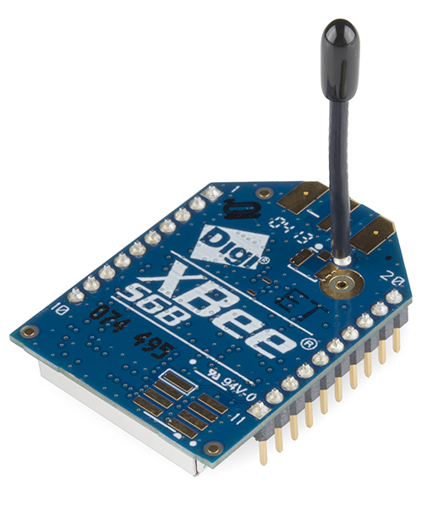
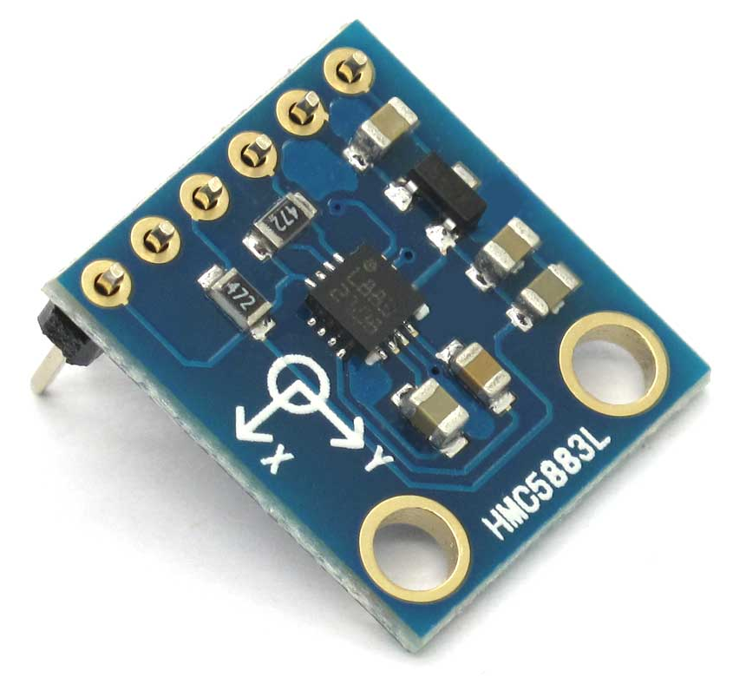
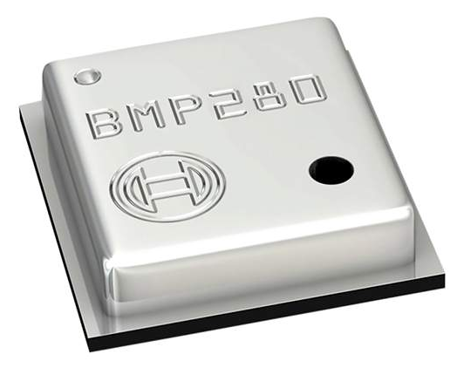
EleTrack’s Ultra-low Power Operation
Barometer
(5µA @5Hz)
Magnetometer
(255µA @5Hz) $\sim$50 times more
Radio Tx
(9.1mA)
$\sim$35 times more
“Sensor-assisted aggressive duty cycling”
Using low-power components to actuate high-power components, only when required.
Notes:
The low-power barometer triggers the moderate-power magnetometer for door detection only when the elevator has stopped at the gateway level. The moderate-power magnetometer, in turn, triggers the high-power radio transmission only when the door opens.

Slide 20
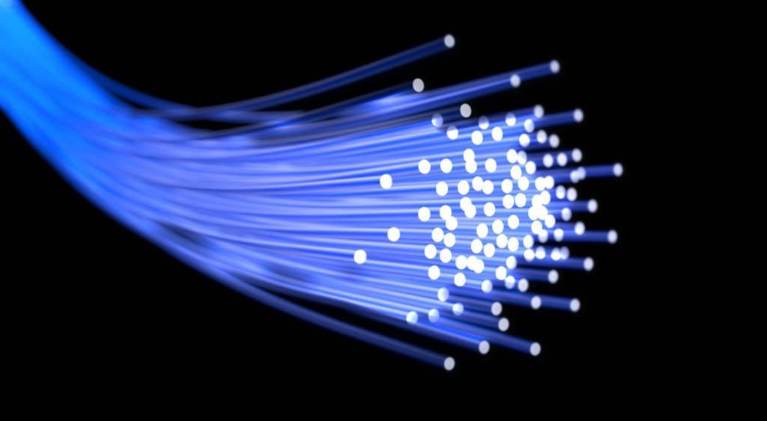
Level Tracker
Door Detector
Data Communicator

Slide 21
Level Tracker
Door Detector
Data Communicator

Slide 22
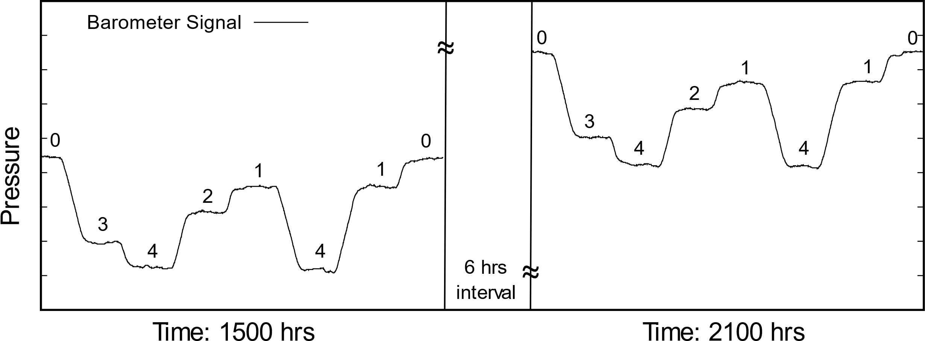
Level Tracker
Straight-forward approach
Use absolute pressure values from the barometer
Doesn’t work in practice!
Building Levels
A
B
A
B
Semi-diurnal atmospheric
pressure tide
However, because this is just a drift,
Pressure difference for a journey remains the same.
Pressure differences for equal and opposite journeys are equal and opposite.
Notes:
This drift in pressure value is due to the semi-diurnal atmospheric pressure tide. Thus, we cannot use the absolute pressure values.

Slide 23
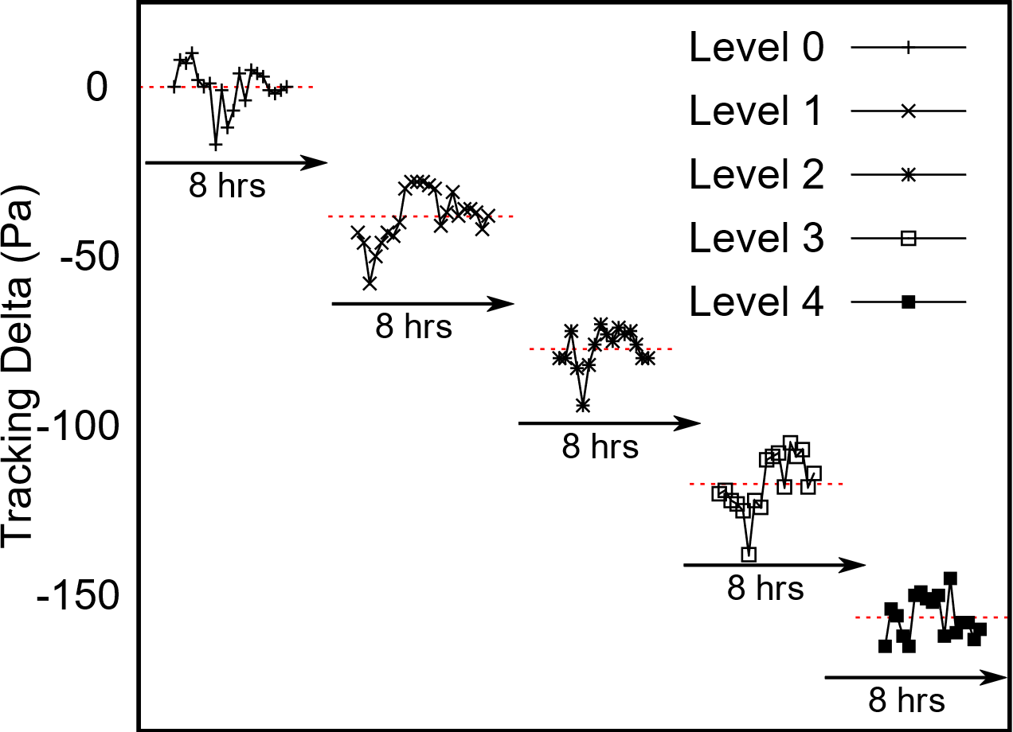
Level Tracker
Key Insight
Tracking Delta = Cumulative sum of journey pressure differences then, tracking delta at a given level would be similar.
Min. cluster separation $≈$ min. floor separation (7ft or 26Pa)
For each level, the tracking delta cluster together
Clusters of tracking delta are well-separated
Due to every building having a finite floor separation
Notes:
Based on our observations our key insight is that …
For example, in this figure we plot the tracking delta for an elevator each time it arrives at the different levels
We see that …
A further insight here is that the minimum separation between these clusters for any building corresponds to the minimum possible floor separation; which according to international standards is about 7ft or 26Pa.

Slide 24
Level Tracker
Online Level Tracking Algorithm
Start: Elevator is at the level of the gateway (Level 0)
Tracking Delta = 0 Pa
Level 0 | 0
Ground Truth
Level 2
Level 1
Tracking Delta Clusters
Level 0

Slide 25
Level Tracker
Online Level Tracking Algorithm
Start at the level of the gateway (Level 0)
Tracking Delta = 0 Pa
Level 0 | 0
Ground Truth
Level 2
Level 1
Tracking Delta Clusters
Level 0

Slide 26
Level Tracker
Online Level Tracking Algorithm
Min. cluster separation = 26 Pa i.e. $±$13 Pa
Recent Journey Delta = -70 Pa | Tracking Delta = -70 Pa
Level 0 | 0
Ground Truth
Level 2
Level 1
Tracking Delta Clusters
Level 0

Slide 27
Level Tracker
Online Level Tracking Algorithm
Min. cluster separation = 26 Pa i.e. $±$13 Pa
Recent Journey Delta = -70 Pa | Tracking Delta = -70 Pa
Level 0 | 0
Level 1 | -70
Ground Truth
Level 2
Level 1
Tracking Delta Clusters
Level 0

Slide 28
Level Tracker
Online Level Tracking Algorithm
Min. cluster separation = 26 Pa i.e. $±$13 Pa
Recent Journey Delta = -70 Pa | Tracking Delta = -70 Pa
Level 0 | 0
Level 1 | -70
Ground Truth
Level 2
Level 1
Tracking Delta Clusters
Level 0

Slide 29
Level Tracker
Online Level Tracking Algorithm
Min. cluster separation = 26 Pa i.e. $±$13 Pa
Recent Journey Delta = +36 Pa | Tracking Delta = -34 Pa
Level 0 | 0
Level 1 | -70
Ground Truth
Level 2
Level 1
Tracking Delta Clusters
Level 0

Slide 30
Level Tracker
Online Level Tracking Algorithm
Recent Journey Delta = +36 Pa | Tracking Delta = -34 Pa
Level 0 | 0
Level 1 | -34
Level 2 | -70
Ground Truth
Level 2
Level 1
Tracking Delta Clusters
Level 0

Slide 31
Level Tracker
Online Level Tracking Algorithm
Recent Journey Delta = +36 Pa | Tracking Delta = -34 Pa
Level 0 | 0
Level 1 | -34
Level 2 | -70
Ground Truth
Level 2
Level 1
Tracking Delta Clusters
Level 0

Slide 32
Level Tracker
Online Level Tracking Algorithm
Recent Journey Delta = -35 Pa | Tracking Delta = -69 Pa
Level 0 | 0
Level 1 | -34
Level 2 | -70
Ground Truth
Level 2
Level 1
Tracking Delta Clusters
Level 0

Slide 33
Level Tracker
Online Level Tracking Algorithm
Recent Journey Delta = -35 Pa | Tracking Delta = -69 Pa
Level 0 | 0
Level 1 | -34
Level 2 | -70, -69
Ground Truth
Level 2
Level 1
Tracking Delta Clusters
Level 0

Slide 34
Level Tracker
Online Level Tracking Algorithm
Works for any building in general
Including buildings with unequal floor heights
Very slow to learn the levels
Elevator needs to visit every level at least once
When a building has floors with equal height
We can do better!

Slide 35
Level Tracker
Fast Level Tracking Algorithm
For buildings with floors of equal height
Idea
$min∆$ = building’s floor separation in terms of pressure difference
Tracking delta is a multiple of $min∆$
$$∴current level=roundINT\left(\frac{tracking delta}{min∆}\right)$$
Q. How do we know the $min∆$?
It can be learned very quickly (< 10 journeys) (details in the paper)

Slide 36
Level Tracker
Fast Level Tracking Algorithm
For buildings with floors of equal height
Idea
$min∆$ = building’s floor separation in terms of pressure difference
Tracking delta is a multiple of $min∆$
$$∴current level=roundINT\left(\frac{tracking delta}{min∆}\right)$$
How do we know the $min∆$?
It can be learned very quickly (< 10 journeys) (details in the paper)

Slide 37
Level Tracker
Door Detector
Data Communicator

Slide 38
Level Tracker
Door Detector
Data Communicator

Slide 39
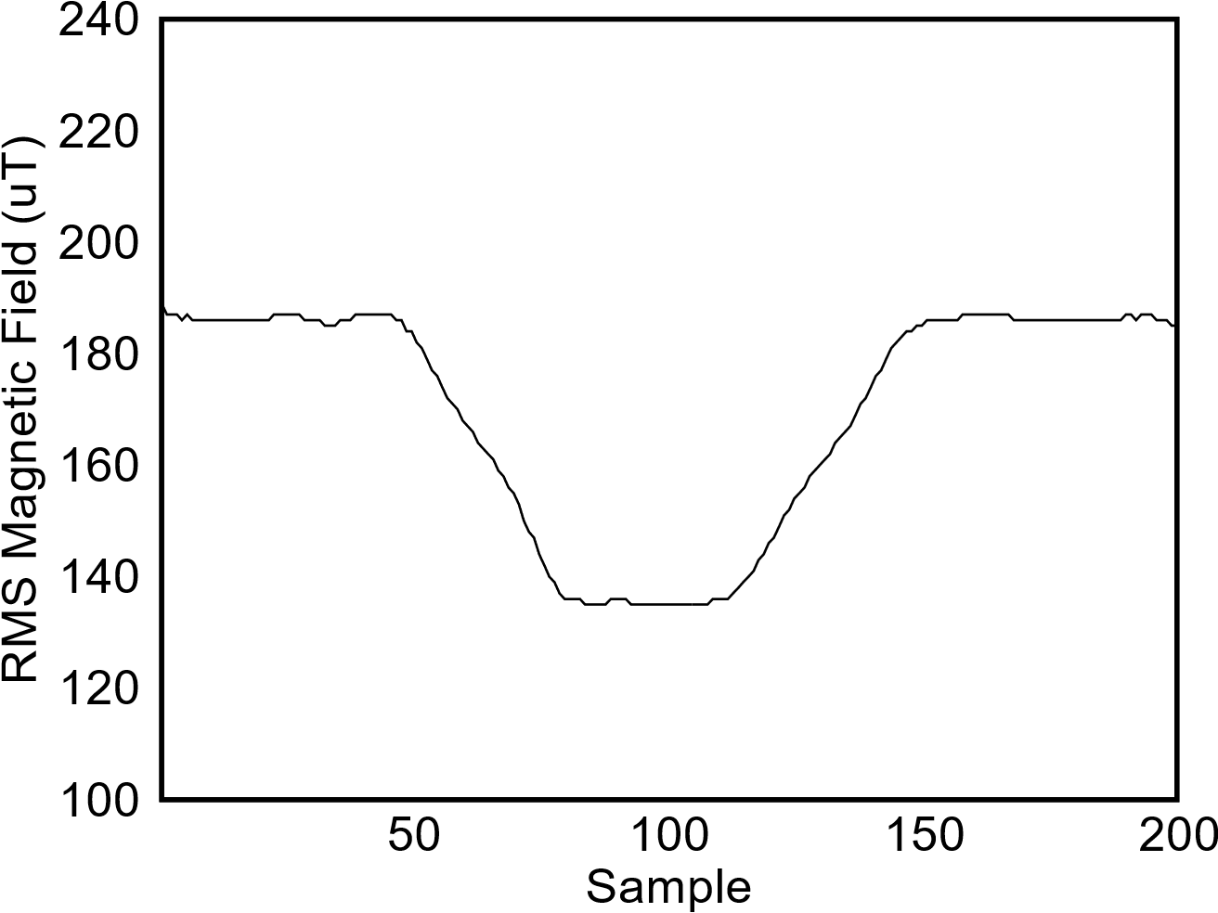
Door Detector
Key idea is based on a simple observation
When a metallic door opens/closes, the magnetic field near the door changes.
Close
Close
Open
Opening
Closing
The property holds in general for all metallic doors
Standard deviation-based edge-detection algorithm

Slide 40
Door Detector
Simple observation
When a metallic door opens/closes, the magnetic field near the door changes.
Close
Close
Open
Opening
Closing
The property holds in general for all metallic doors
Standard deviation-based edge-detection algorithm

Slide 41
Level Tracker
Door Detector
Data Communicator

Slide 42
Level Tracker
Door Detector
Data Communicator

Slide 43
Data Communicator
Goal
Transmit maximum data within a short Tx window
Our data transmission scheme
Uses streaming network coding combined with B-ACKs for 802.15.4
Luby Transform (LT) codes
simple encoding/decoding algorithms for resource constrained devices
For LT encoding: Growth Codes (SIGCOMM ’06) as the degree distribution
enable faster decoding with a small number of codewords
Notes:
Why Growth Codes?
Because growth codes enable faster decoding with a small number of codewords.
More on Growth Codes: The code grows with time: initially codewords are just the symbols themselves, but over time, the codewords become linear combinations of (randomly selected) growing groupings of data units. A well-designed code will grow at a rate such that the size of the codeword received by the sink is that which is most likely to be successfully decoded and deliver previously unrecovered data.

Slide 44
Data Communicator
K journeys
Data for N journeys
Encoder
Decoder
On-the-fly Gaussian Elimination
Infinite stream of codewords

Slide 45
Data Communicator
K journeys
Data for N journeys
Encoder
Decoder
On-the-fly Gaussian Elimination
Infinite stream of codewords
Block-ACK
Process repeats until
no more journey data OR
Tx window closes

Slide 46
Data Communicator
K journeys
Data for N journeys
Encoder
Decoder
On-the-fly Gaussian Elimination
Infinite stream of codewords
Block-ACK
Process repeats: no more journey data OR Tx window closes

Slide 47
Level Tracker
Door Detector
Data Communicator
Notes:
These three techniques work together to help achieve EleTrack’s ultra-low power operation

Slide 48
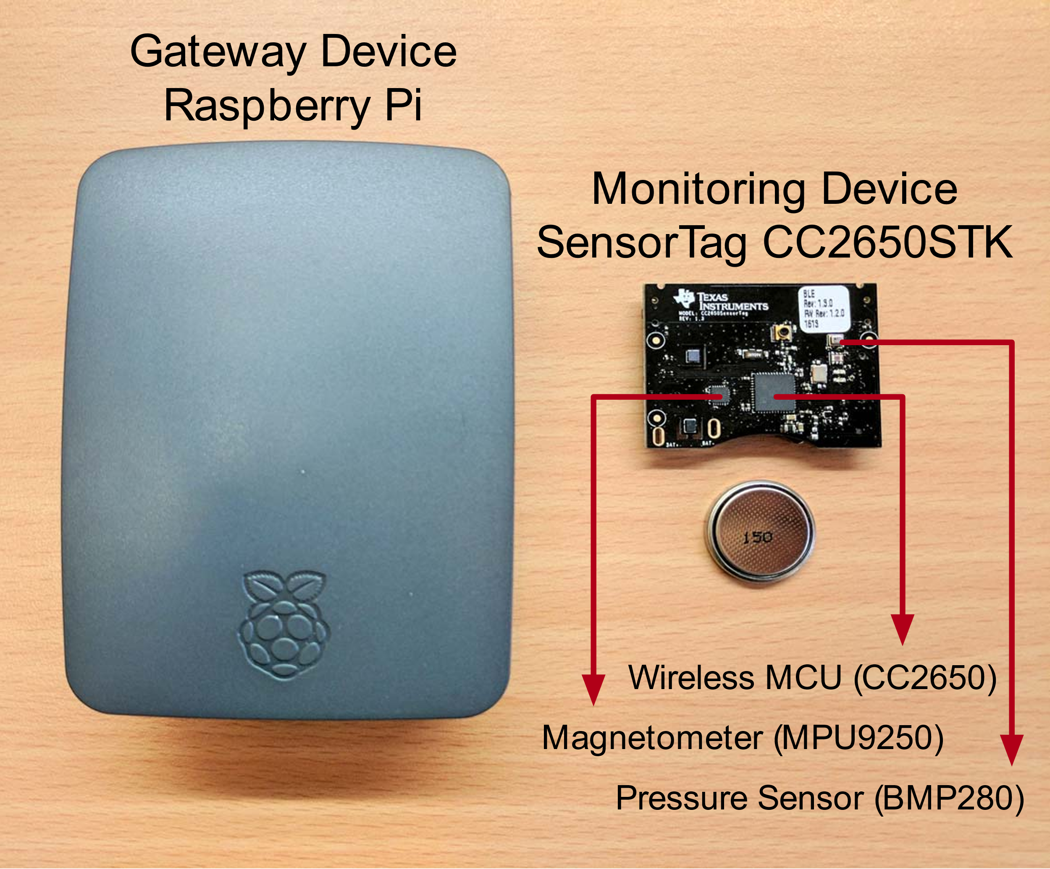
Prototype Implementation
Notes:
We have implemented EleTrack using Texas Instrument’s SensorTag for the monitoring device and a Raspberry Pi for the gateway device.

Slide 49
Evaluation

Slide 50
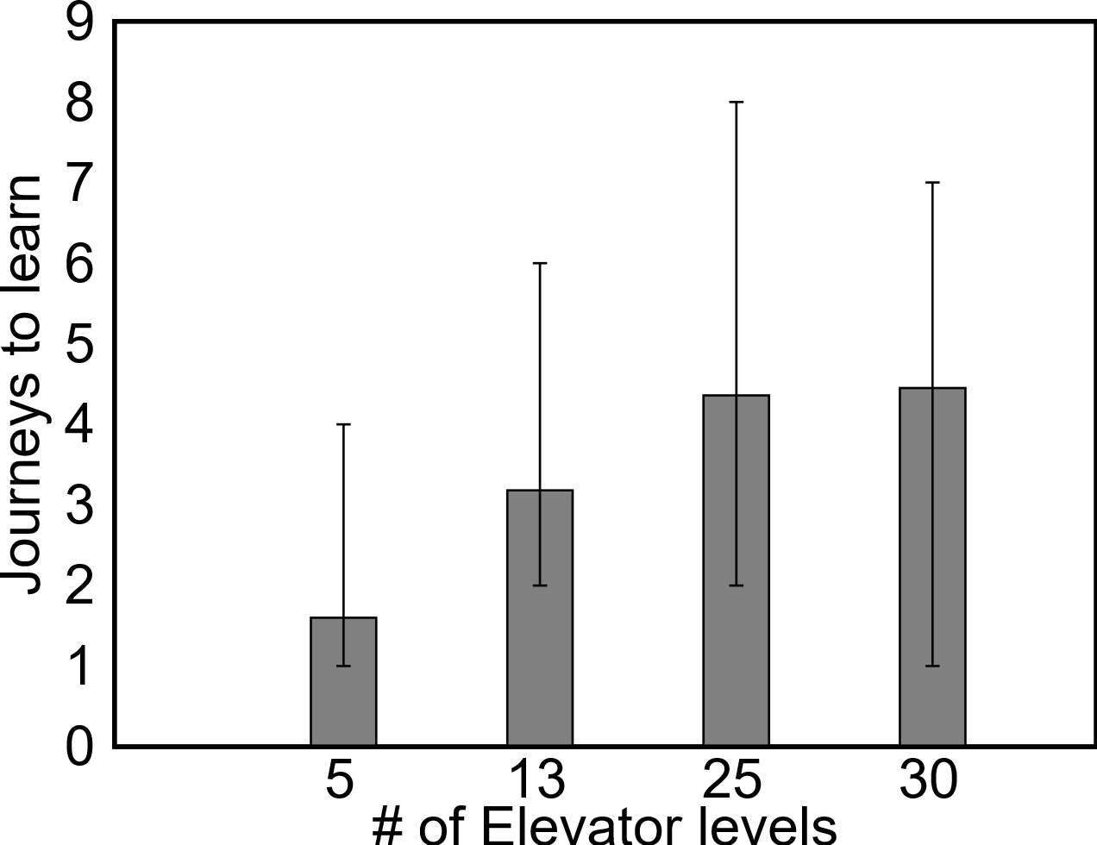
Journeys to learn min$∆$
Doesn’t depend on the number of levels of the building!

Slide 51
Level Tracking Accuracy after learning min$∆$
 | Ele A | Ele B | Ele C | Ele D
Max Elevator Floors | 3 | 5 | 7 | 25
Total Journeys | 24 | 1047 | 300 | 45
Accuracy after learning min$∆$ | 100% | 100% | 100% | 97.8%

Slide 52
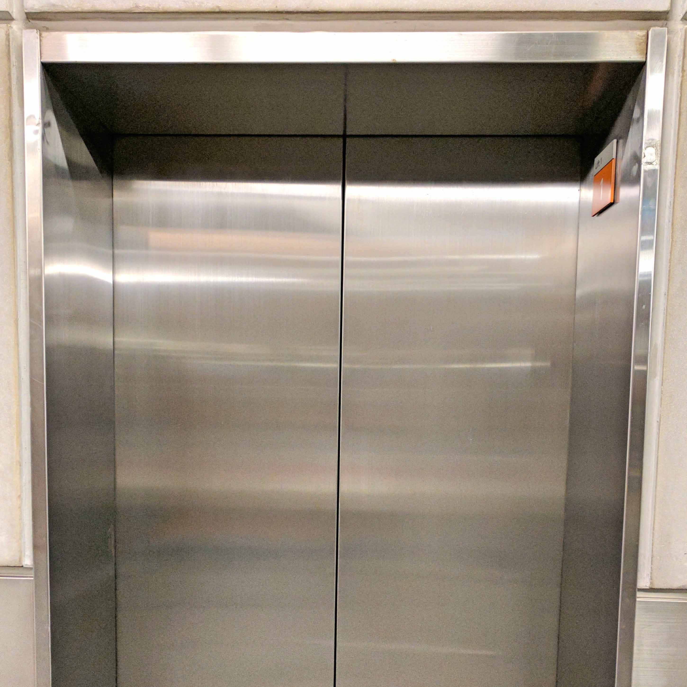
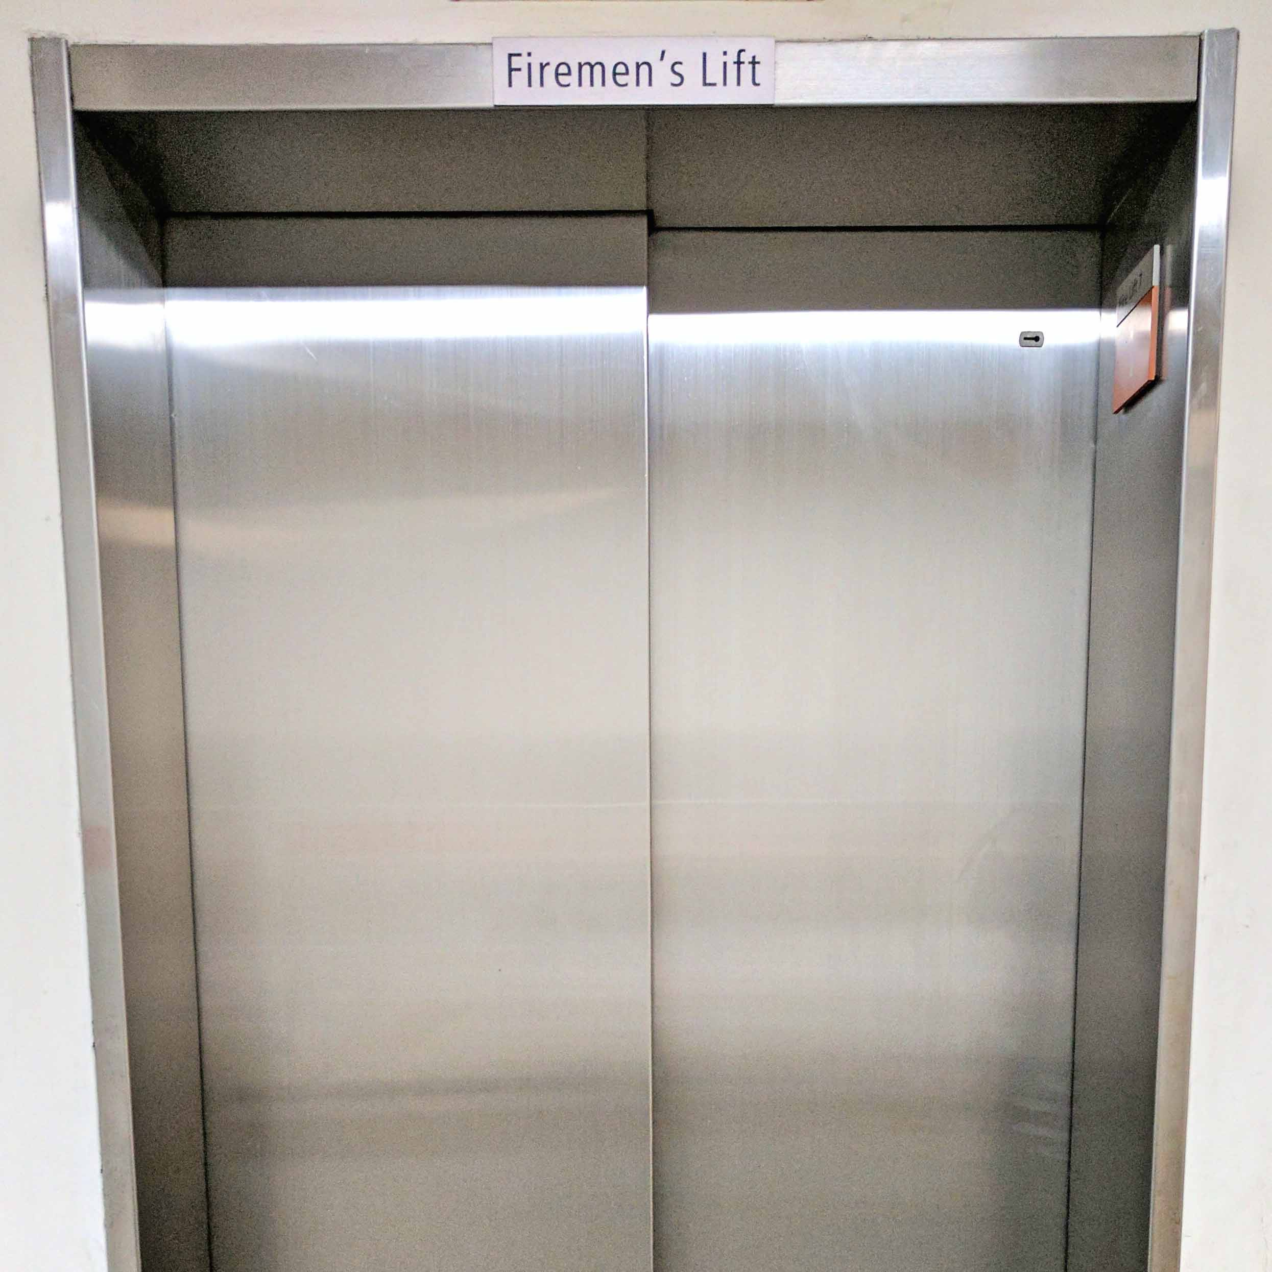
Door Detection Accuracy
Center Opening
Sliding Telescopic
Accuracy = 100%

Slide 53
Stand-by Radio Power Consumption
 |  | ContikiMAC |  | EleTrack
 | Actual Current (µA) | Active Time Fraction | Actual Current (µA) | Active Time Fraction | Actual Current (µA)
MCU | 35 | 100% | 35 | 100% | 35
Barometer @5Hz | 5 | 0% | 0 | 100% | 5
Magnetometer @5Hz | 255 | 0% | 0 | 0.3% | 0.76
Radio @8Hz | 95 | 100% | 95 | 0% | 0
Total Current Drawn |  |  | 130 |  | 40.76
3.19 times lower
Standby time of up to 2.8 years on a 1Ah coin cell battery
Notes:
We compared EleTrack’s stand-by power consumption of the radio with the state-of-the-art ContikiMAC radio duty-cycling protocol.

Slide 54
Findings from Preliminary Deployments

Slide 55
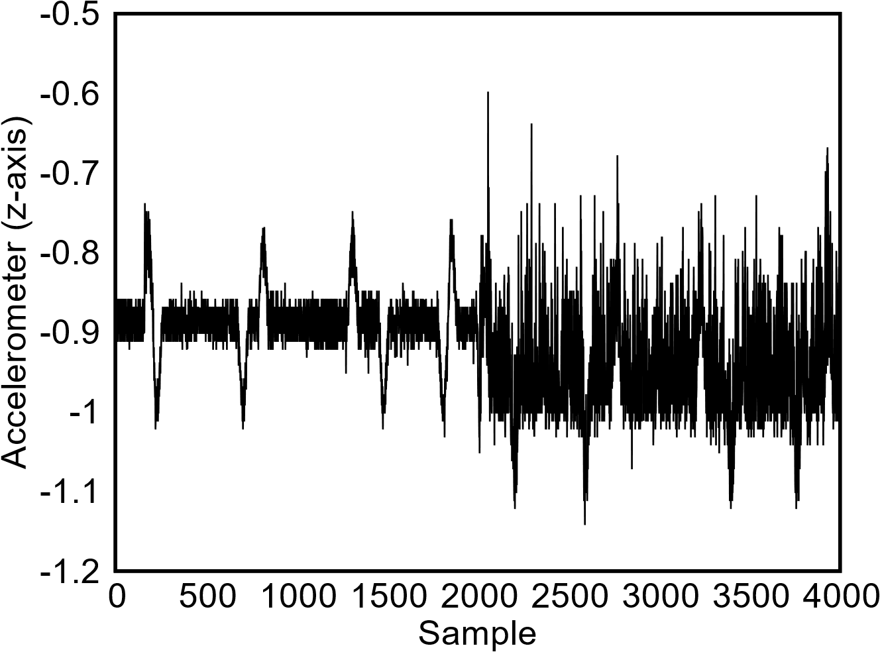
Accelerometer Data ➔ Rough Journeys
Smooth
Rough
Elevator was empty

Slide 56
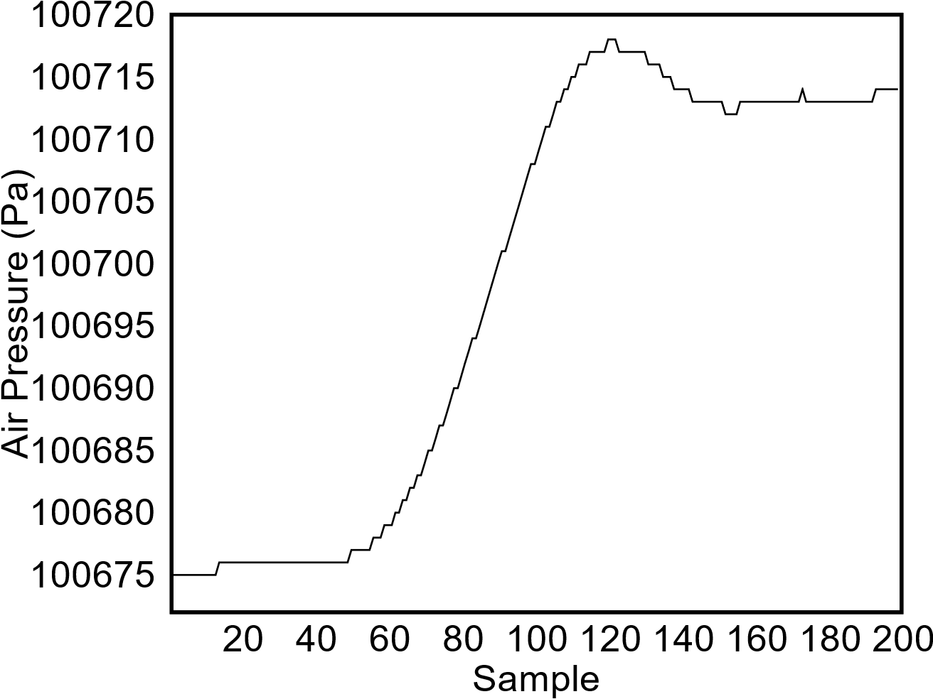
Barometer Data ➔ Overshooting Rides
Overshoots

Slide 58
Conclusion
EleTrack
An ultra-low power, plug-n-play monitoring platform to retrofit existing elevators.
Sensor-assisted aggressive duty cycling
Useful approach in scenarios with deterministic transmission window.
Exploited by other applications, where possible.
Notes:
We have demonstrated that sensor-assisted aggressive duty cycling is a useful approach in scenarios with deterministic transmission window and should therefore be exploited by other applications where possible.
As we speak, EleTrack is currently being commercially deployed on many elevators across Singapore. For commercial enquiries, feel free to contact the lead author ☺

Slide 59
Conclusion
Commercial Deployment
On several elevators across Singapore
In future:
Use the real world data from our deployments
Build data models ➔ predictive maintenance
For commercial enquiries
Notes:
We have demonstrated that sensor-assisted aggressive duty cycling is a useful approach in scenarios with deterministic transmission window and should therefore be exploited by other applications where possible.
As we speak, EleTrack is currently being commercially deployed on many elevators across Singapore. For commercial enquiries, feel free to contact the lead author ☺

Slide 60
Notes:
Thank you very much for your kind attention and I would be happy to take a few questions

Slide 62
Tracking Delta Error Accumulation
No formal guarantees, but …
Elevators go both up and down
In practice, error is zero mean (unless the barometer sensor has a biased error >_<)
Workaround
Cluster journey pressure differences
Add the centroid of cluster with correct sign
Scope for Correction
Detect incorrect gateway level based on RSSI, no ACKs
Trigger data communicator more often ($±$1 level)

Slide 63
Insufficient Tx window OR Excess Data
Tradeoff: Energy consumption and Tx speed
Wifi much faster, but consumes more power
We can deal with this better!
High-rise elevators have multiple “rest” levels
Multiple gateways and thus multiple Tx windows
Notes:
External flash on SensorTag cc2650 = 4 MB
Accelerometer sampling (5 Hz x 32 bits of z-axis reading) = 160 bits/s.
Total data can be buffered = 200,000 seconds = 55 hours!!

Slide 64
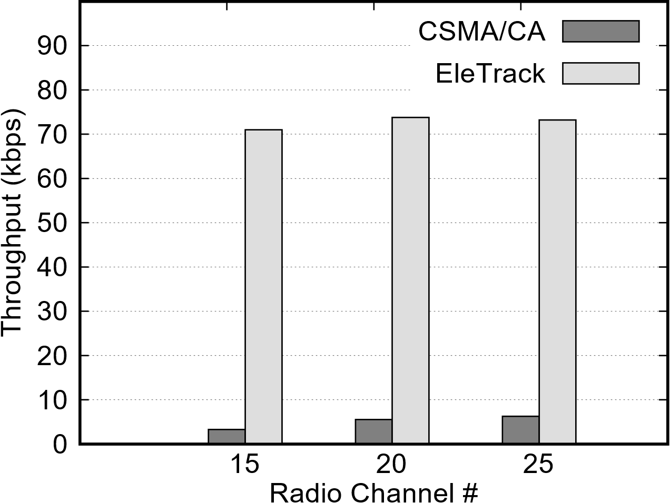
Throughput gains from the Tx scheme

Slide 65
Choosing the block size k
Insensitive parameter
No sensitivity analysis in paper (lack of space)
General guidelines to choose k
Larger the k, better the overall throughput!
Coding theory perspective
Also, less blockACKs
Not too large
Exceed the Tx window
Increase the size of extra packet header

Slide 66
Packet Format

